Slide 1
Update on MASLD (MAFLD or NAFLD), MASH (NASH) and Diabetes
Zobair M Younossi MD, MPH, FACP, AGAF, FACG, FAASLD
Chairman, the Global NASH Council (GNC)
President, Chronic Liver Disease Foundation (CLDF)
Washington DC, United States
Professor and Chairman of Beatty Liver and Obesity Research,
Inova Health System
Falls Church, Virginia, United States
Disclosures: Research funding and/or consultant to Intercept, Cymabay, Boehringer Ingelheim, Ipsen, BMS, GSK, NovoNordisk, Siemens, Madridgal, Merck, Aligos, Akero and Abbott.

Slide 2
From NAFLD to MAFLD to MASLD
NAFLD as spectrum of clinic-pathologic diseases with >5% hepatic steatosis with or without other histologic features in the absence of excessive alcohol use (20 and 30 g/d) and other CLD
Younossi ZM, et al. Mod Pathol. 1998 Jun;11(6):560-5, Matteoni CA, Younossi ZM et al. Gastroenterology 1999. 116: 1413-1419
Issues:
  Fatty liver can be stigmatizing
  NAFLD is a negative term and does not connect to underlying root cause (metabolic)
  5% of NAFLD patients don’t make the diagnosis of MASLD. They are younger with some IR but no overt CMRs which are required for MASLD (“early disease”?)
  Although there is no perfect term, there is a great deal of overlap
  I will use these terms interchangeably
Paik J and Younossi Z AASLD 2024, Rinella M et al Hepatology 2023

Slide 3
Comprehensive Disease Burden of MASH
Younossi ZM, et al. Hepatology. 2016;64(5):1577-1586; 2. Younossi ZM. Clin Gastroenterol Hepatol. 2017;15(8):1144-1147, 3. Younossi Z Hepatology. 2018 Aug 2
Notes:
Crude death rates:
- Number of deaths in time period over those at risk of dying in period
Years of Potential Life Lost:
- Measure of the loss of future productive years resulting from a specific cause of death. Indicates the potential burden related to when death occurs.
Life-expectancy, expected years of life lost, and potential years of life lost
Liver-related outcomes that drive mortality
- Ascites and its complications, VH, HE, HCC, ACLF
- Stage of fibrosis, SVR

Slide 4
Disease Burden
Global Prevalence of MASLD
General Population
Younossi ZM, et al. Hepatology. 2023 Jan 3. doi: 10.1097/ Epub ahead of print. PMID: 36626630.
T2D Population
Younossi ZM,Clin Gastroenterol Hepatol. 2024 Mar 21:S1542-3565(24)00287-8
Younossi ZM,Clin Gastroenterol Hepatol. 2024 Mar 21:S1542-3565(24)00287-8

Slide 5
The Growing Burden of Pediatric MASLD
Prevalence of MASLD in Children and Young Adults
NHANES 2007-2016
Incidence of MASLD in Children 2009-2018
Sahota A et Al Pediatrics 2020
Arshad T, Younossi Z Hep Comm 2021
Notes:
The pooled regional NAFLD incidence rate estimates for Asia and Israel
were 52.34 per 1,000 (95% CI: 28.31-96.77) and 28.01 per 1,000 person-years (95% CI: 19.34-40.57),
respectively.

Slide 6

Pathogenic Pathways: Multiple Hits and Pathways
Fat accumulation drives injury
Endothelial Cell Dysfunction
Scar formation/
Fibrosis
Hepatic stellate cells
TGF-ß
TNF
Maturation
Inflammatory macrophages
Hepatocyte
Inflammatory monocytes
ECM deposition (collagen formation)
Visceral Adiposity Insulin Resistance
Activation/
trans-differentiation
IL-1ß
Oxidative Stress
PDGF
Secondary Inflammation and Injury
Proliferation
Kupffer cells
Bacterial translocation (endotoxins)
PAMPs
Activated myofibroblast
Activated myofibroblasts
DAMPs
Dysbiosis
Inflammatory Mechanisms
Fibrosis
DAMP, danger-associated molecular patterns; ECM, extracellular matrix; IL-1β, interleukin-1beta; PAMP, pathogen-associated molecular patterns; PDGF, platelet-derived growth factor; TGF-β, transforming growth factor beta; TNF, tumor necrosis factor; TNF-β, tumor necrosis factor-beta.
Benedict M, Zhang X. World J Hepatol. 2017;9(16):715-732; Bedossa P. Liver Int. 2017;37(suppl 1):85-89; Younossi ZM, et al. Hepatology. 2011;53(6):1874-1882.

Slide 7

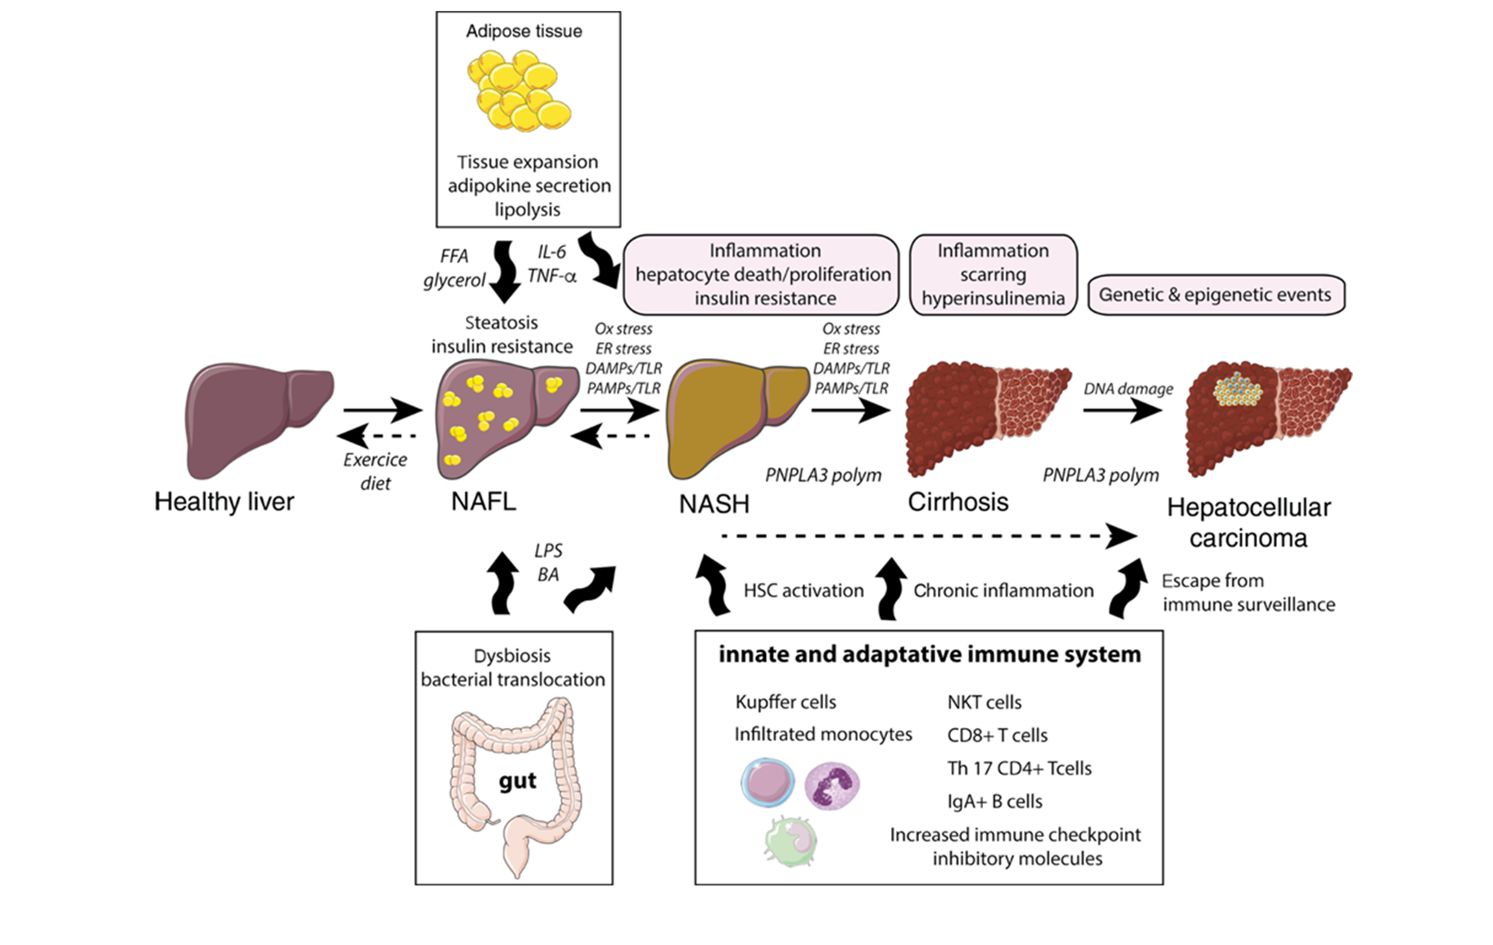
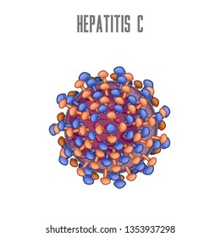
Disease Burden
Natural History of SLD, MASLD and MASH
Non-linear Progression
15-20% progress
2.3% per year
Fibrogenesis
Fibrolysis
SLD
MASH/MASLD
Sayiner M, et al. Clin Liver Dis. 2016;20(2):205-214; Younossi ZM, et al. Hepatology. 2016; 64(5):1577-1586. Lequoy M, et al. Horm Mol Biol Clin Investig. 2020, 29;41(1), Younossi Z et al. Hepatology 2018, Younossi Z J Hepatology 2019
Younossi Z et al. EMJ Hepatol. 2022

Slide 8
MASLD Cirrhosis is the Most Common Cause of Cirrhosis in the US
NHANES 2017-2020 (N=9,693 )
Cirrhosis was evaluated by LSM or FIB-4 score.
General Population Prevalence of CLD-Cirrhosis (%)
Higher risk of cirrhosis in Hispanics vs. non-Hispanic whites (HR 1.80, 95% CI 1.49 – 2.19
Compared to baseline FIB-4 < 1.3, significantly higher risk of cirrhosis in
  FIB-4 1.3-2.67 (HR 3.19, 95% CI 2.63-3.87)
  FIB-4 > 2.67 (HR 25.5, 95% CI 21.1-30.4)
predictor of cirrhosis in CLD | OR (95% CI) | p
Male sex | 2.3 (1.3 – 4.0) | 0.0069
Obesity | 2.6 (1.6 - 4.4) | 0.0006
Type 2 diabetes | 1.6 (1.0 - 2.6) | 0.0415
Hypertension | 2.2 (1.2 – 4.0) | 0.0101
Younossi ZM et al, AASLD 2024
Yeoh, et al J Clin Gastroenterol 2023

Slide 9
Consequences of NASH/MASH:
Cirrhosis, Liver Transplantation and Mortality
Cause of Mortality in MASLD
Per 1,000 person-yrs
All NAFLD/MASLD
NAFLD/MASLD with T2D
NAFLD/MASLD Cirrhosis
Younossi ZM et al, Hepatology. 2023 Apr 1;77(4):1335-1347, Younossi ZM. Et al Clinical Gastro and Hepatology 2024, Owrangi S, Z Younossi DDW 2024

Slide 10
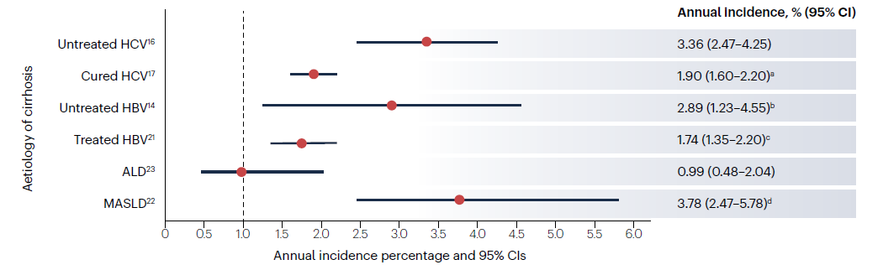
Hepatocellular Carcinoma in MASH
Data from global studies and systematic reviews illustrate annual incidence of HCC in cirrhosis by underlying liver disease etiology
HCC in MASH Cirrhosis
LT: HCC and MASLD
HCC incidence in MASH cirrhosis significantly higher than non-cirrhotic
HCC incidence ranging from 2.6% annual cumulative incidence among cirrhotic patients referred for LT
Incidence of 0.08 to 0.6 per 1000 PY
Asian studies report annual incidence of HCC: 0.04% to 0.6%
European studies reported HCC incidence 0.22 per 1000 in Spain to 0.57 per 1000 in UK.
HCC
HCC in Non-Cirrhotic MASLD
Non-HCC
Singal, et al. Nat Rev Clinical Oncology 2023
Huang, et al. Nat Rev Gastro Hep 2021
Younossi ZM, Hepatol Commun. 2023
Notes:
Annual risk of HCC in patients with cirrhosis stratified according to the
major underlying aetiology. The data on the annual incidence of hepatocellular
carcinoma (HCC) in the various aetiological subgroups of patients with cirrhosis
are derived from systematic reviews, when possible, that included studies from
across the world. The dotted line indicates the annual HCC incidence threshold
beyond which HCC surveillance might be cost-effective. ALD, alcohol-related
liver disease; HBV, hepatitis B virus infection; HCV, hepatitis C virus infection;
MASLD, metabolic-associated steatotic liver disease. aGeographical setting
was not associated with HCC incidence in a meta-regression. bEstimates are
for North America; heterogeneity in HCC incidence was observed by region,
and the corresponding estimates from Europe and Asia were 2.03% (95% CI
1.30–2.77%) and 3.37% (95% CI 2.48–4.26%), respectively. cFive-year cumulative
incidence of HCC ranged from 4.5% to 21.6% across cohorts of patients with
compensated cirrhosis in a systematic review and meta-analysis of 19 studies18.
dHCC incidence is considerably lower in prospective cohort studies of patients
with MASLD-related cirrhosis: 1.24% (95% CI 0.74–1.73%)15.

Slide 11
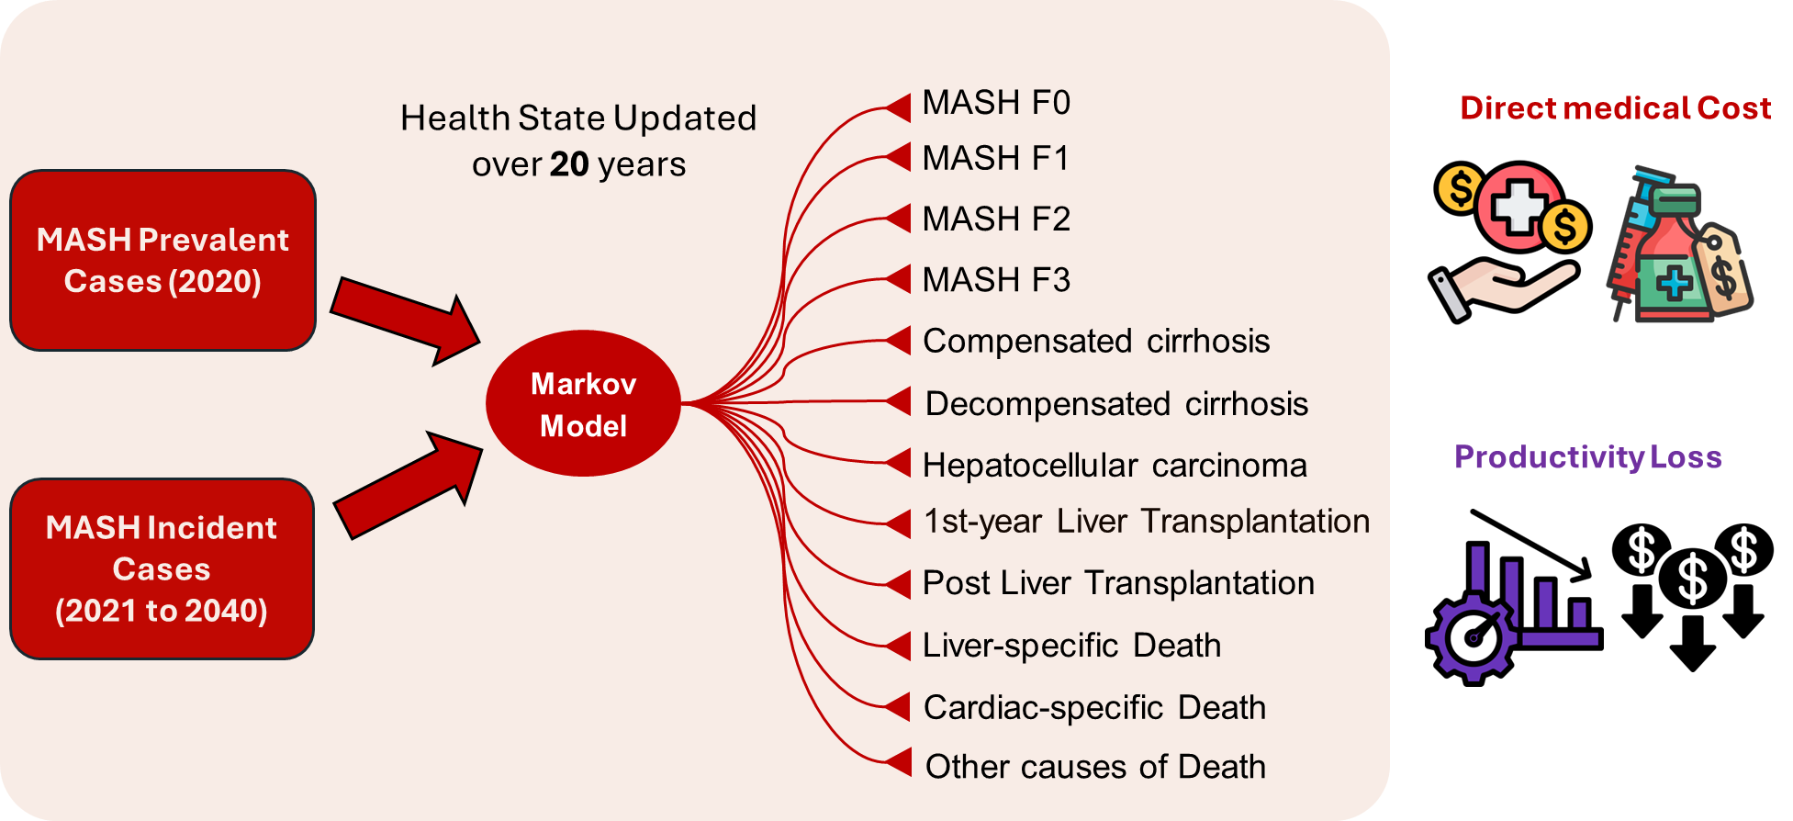
Future Clinical and Economic Burden
A Markov Model was used to estimate the MASH-related direct costs, societal costs, and health outcomes for both MASH prevalent cases in the U.S. (2020) and new (incident) cases (2021-2040).
The disease states and mortality status were updated over 20-years based on probabilities that are specified for transitioning from one health state to another (hereafter, transition probabilities).
Perspective: Societal
Markov Model Process
Younossi Z et al. ILC 2024, Younossi Z et al AASLD 2024
Notes:
Cost of Inaction for Metabolic Dysfunction Associated rden of MASHhepatitis (MASH): The Projected Economic Burden in the United States, Germany, Spain, Japan, Saudi Arabia and Brazil

Slide 12
Projected Clinical Burden of MASH in the US, Germany, Spain, Brazil, Saudi Arabia and Japan (2021-2040)
Direct Healthcare Cost
Indirect Cost of Work Productivity Loss
Younossi Z et al. ILC 2024, Younossi Z et al AASLD 2024

Slide 13
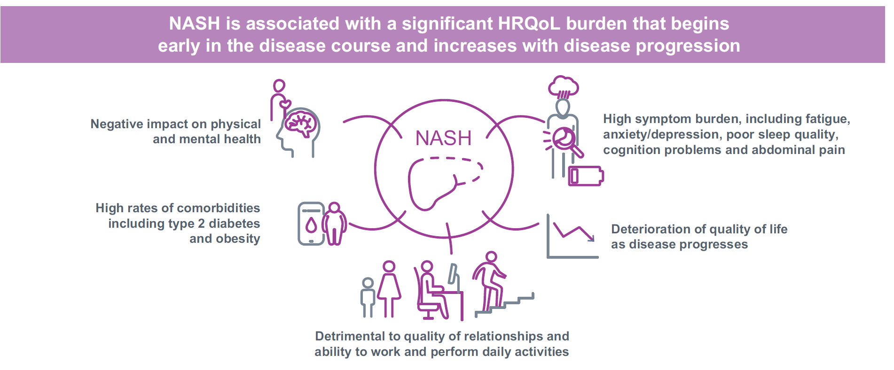
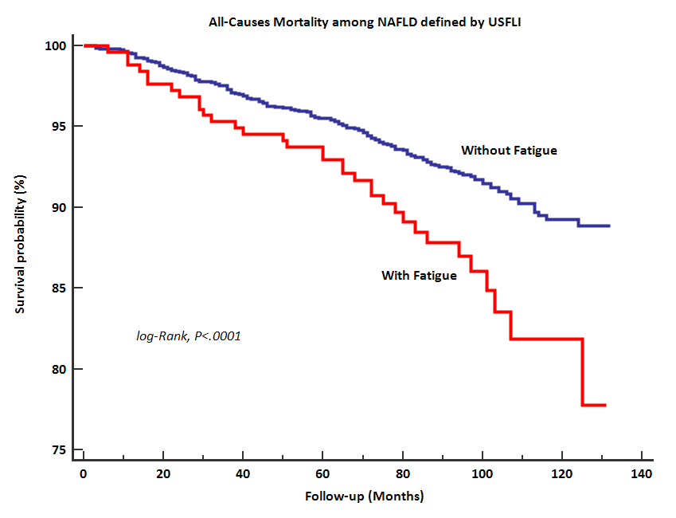
The Burden of Non-alcoholic Steatohepatitis:
A Systematic Review of HRQL and PROs
NHANES 2005-2010 (N= 5,429)
Patients with biopsy-proven NASH (N=1669
MVA: NAFLD patients with fatigue experienced 2.3-fold higher mortality rate than NAFLD without fatigue (HR: 2.31, 95%CI: 1.37-3.89, P=0.0024).
Younossi Z, et al.. JHEP Rep. 2022 Jun 15;4(9):100525, Younossi Z et al AASLD 2019, Younossi Z et al Gastro and Hep 2019, Younossi ZM, et al Clin Gastroenterol Hepatol. 2022, Younossi Z et al Liver International 2022

Slide 14
Drivers of Disease Burden
ETHNICITY
AGE
Non-Modifiable
Risk Factors
GENDER
FAMILY
HISTORY
ABDOMINAL
OBESITY
HIGH
BLOOD
PRESSURE
MASLD
Modifiable
Risk Factors
ACTIVITY
DIABETES
SLEEP /
MOOD
POOR
NUTRITIONAL
QUALITY
Arsenault B et al. The Conversation Feb 27, 2022, https://theconversation.com/uncovering-the-genetic-causes-of-fatty-liver-disease-a-growing-health-concern-176641, Stefan N, Cusi K. Lancet Diabetes Endocrinol. 2022 Apr;10(4):284-296, Younossi ZM et al. Hepatology. 2016;64:73–84; Younossi ZM. J Hepatol. 2019;70:531–544., Younossi ZM, et al. Gut. 2020 Mar;69(3):564-568, Arshad T, Paik J, Biswas R, Alqahtani S, Henry L, Younossi ZM. Hepatology Communications. 2021, Younossi, Z.,. et al. Nat Rev Gastroenterol Hepatol 15, 11–20 (2018). , AISF_SIO_SID CPG NAFLD Dig Liv Dis. 2021; Manolio TA. Nat Rev Genet. 2013;14(8):549-558., Zelber-Sagi S, Carrieri P, Pericàs J, Ivancovsky Wajcman D, Younossi ZM, Lazarus JV. NRGH 2024 (In Press
.

Slide 15
Metabolic Syndrome is a Driver of Mortality
20,026 Adults (NHANES III & NHANES 1999-2006)
FU of 23.1 years with 2,875 premature deaths.
Highest premature mortality in VH with MetD, MetALD, ALD with MetD, and MASLD.
Alcohol consumption increases the risk
Increased numbers of CMR are associated with premature death
Paik J and Younossi AASLD 2024
Golabi P, et al. Medicine 2018;97(13):e0214,

Slide 16
Drivers of Disease Burden
ETHNICITY
AGE
ABDOMINAL
OBESITY
HIGH
BLOOD
PRESSURE
Non-Modifiable
Risk Factors
Modifiable
Risk Factors
ACTIVITY
DIABETES
GENDER
FAMILY
HISTORY
SLEEP /
MOOD
POOR
NUTRITIONAL
QUALITY
Food insecurity Contributing to Obesity, T2D and MASLD
MASLD
Arsenault B et al. The Conversation Feb 27, 2022, https://theconversation.com/uncovering-the-genetic-causes-of-fatty-liver-disease-a-growing-health-concern-176641, Stefan N, Cusi K. Lancet Diabetes Endocrinol. 2022 Apr;10(4):284-296, Younossi ZM et al. Hepatology. 2016;64:73–84; Younossi ZM. J Hepatol. 2019;70:531–544., Younossi ZM, et al. Gut. 2020 Mar;69(3):564-568, Arshad T, Paik J, Biswas R, Alqahtani S, Henry L, Younossi ZM. Hepatology Communications. 2021, Younossi, Z.,. et al. Nat Rev Gastroenterol Hepatol 15, 11–20 (2018). , AISF_SIO_SID CPG NAFLD Dig Liv Dis. 2021; Manolio TA. Nat Rev Genet. 2013;14(8):549-558., Zelber-Sagi S, Carrieri P, Pericàs J, Ivancovsky Wajcman D, Younossi ZM, Lazarus JV. NRGH 2024 (In Press
.

Slide 17
Drivers of Disease Burden:
Social Determinants of Health and Food Insecurity
MASLD/NAFLD Prevalence by Sex, Age, and Race Among Adolescent Children
NHANES 2017-2018.
In US, 10.8% (4.27 million) adolescents have MASLD
In adolescents (aged 12-18), 9.8% reported food insecurity.
Overall, prevalence of MASLD is higher among food insecure adolescents
This was especially prominent among girls and minorities in the US
The prevalence of MASLD/NAFLD was greater among adolescents living with a low HH income vs. a higher HH income and living with a head of HH with a lower education level vs. a higher education level.
Association of Food Insecurity, Household Income, and Education Level With MASLD Among Adolescent in the US
Paik J and Younossi Z Am J Gastroenterol 2024
* Statistically significant difference by food insecurity (P<.05)

Slide 18
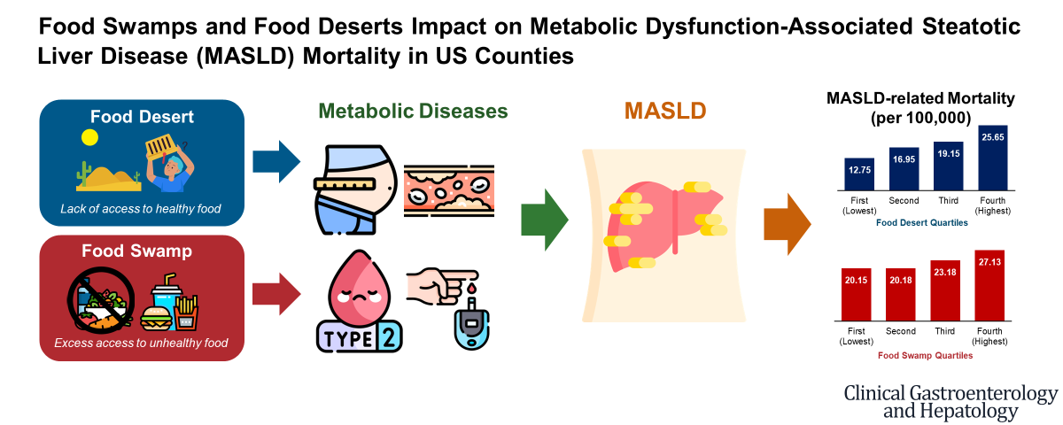
Drivers of Disease Burden: Social Determinants of Health and Food Insecurity
Food Swamps and Food Deserts Impact on MASLD Mortality in US Counties
MASLD deaths from NVSS (2016-2020)
Food environment factors from Food Environment Atlas (FEA)
  Food deserts are areas where low-income residents have limited access to affordable and nutritious food due to a scarcity of nearby grocery stores.
  Food swamps are areas oversaturated with outlets offering limited healthy food options.
From PLACES data, we used:
  Agency for Healthcare Research and Quality (AHRQ) Social Determinants of Health (SDOH) Database (2020)
  SODH measures for County, ACS 2017-2021
  Local Data for Better Health, County Data 2023
After adjusting for confounders, regression models showed differences in mortality rates (per 100,000) between counties with the highest versus lowest quartiles of food deserts (25.65 vs. 12.75, adjusted difference=3.66 [95% CI: 2.66–4.72]) and food swamps (27.13 vs. 20.15 per 100,000, adjusted difference=3.57 [95% CI: 2.44-4.71]).
Paik A and Younossi Z Clin Gastro and Hep 2024

Slide 19

Global Drivers of Disease Burden:
Prevalence By Food Environment Metrics According to Socio-economic Index
Data from Food and Agriculture Organization (FAO) of UN (2016-2019) and GBD 2021
Food Environment metrics were defined cost of a healthy diet, unaffordability of a healthy diet, undernourishment, and food insecurity.
Association of food Environment with Prevalence were determined according to Socio-demographic Index
Globally, in 2021
1.7 billion people
Had MASLD
2.4 billion people
experienced food insecurity,
meaning they did not have access to adequate food
In highly developed countries food environment contribute to food imbalance (poor food quality) and high MASLD
In less developed countries, nutrient deficiencies (hunger) leads to lower rates of MASLD.
These findings highlight the significant geographical variability in MASLD prevalence, driven in part by socio-economic differences and food environments, emphasizing the need for targeted public health strategies that consider both factors to reduce the global burden of MASLD.
Younossi z et al J of Hepatology 2024

Slide 20
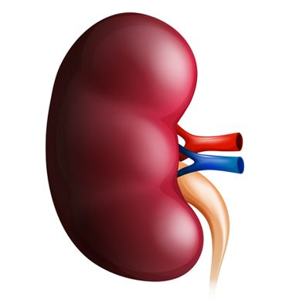
MASH is a Part of Multi-systemic Metabolic Diseases
Extra-Hepatic Diseases Associated with MASH
CKD
Younossi Z et al 2020

Slide 21
Prevalence of MASLD in CAD
(NHANES 2017-2020)
MASLD and Cardiac
N=6477
*
Younossi Z 2024

Slide 22
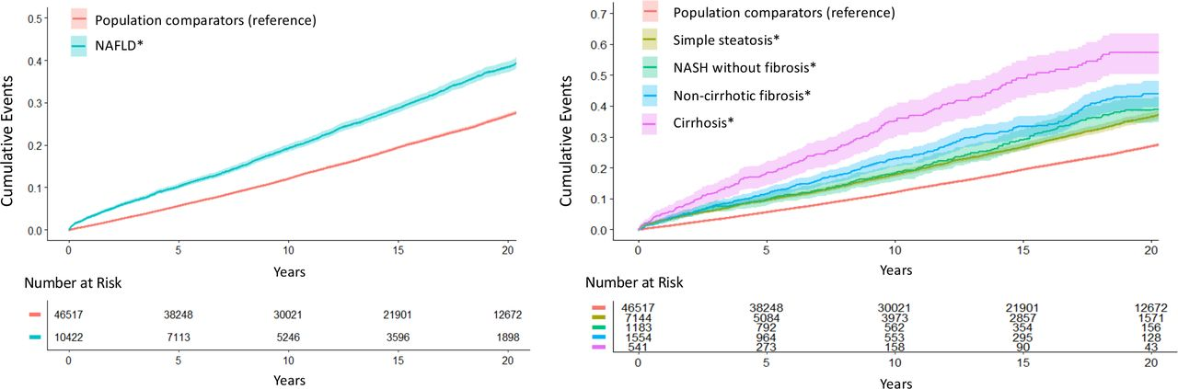
Independent Association Between MASLD and CVD
Population-based cohort included all Swedish adults with histologically confirmed MASLD and without CVD at baseline (1966-2016, n=10,422) and matched controls, n=46,517.
0.5
Population comparators (reference)
0.7
Population comparators (reference)
NAFLD*
0.6
Simple steatosis*
0.4
0.5
NASH without fibrosis*
0.3
0.4
Non-cirrhotic fibrosis*
Cumulative Events
Cumulative Events
Cirrhosis*
0.2
0.3
0.2
0.1
0.1
0.0
0.0
0
5
10
15
20
0
5
10
15
20
Number at Risk
Years
Number at Risk
Years
46517
10422
38248
7113
30021
5246
21901
3596
12672
1898
46517
7144
1183
1554
541
38248
5084
792
964
273
30021
3973
562
553
158
21901
2857
354
295
90
12672
1571
156
128
43
0
5
10
15
20
0
5
10
15
20
Years
Years
Incident MACE All MASLD: HR=1.63; cirrhosis: HR=2.15
CV death: all MASLD: HR=1.37; cirrhosis: HR=2.12
Simon TG et al. Non-alcoholic fatty liver disease and incident major adverse cardiovascular events: results from a nationwide histology cohort. Gut. 2022.

Slide 23
Prevalence of MASLD in CKD
(NHANES 2017-2020)
MASLD and CKD
n=6022
*
Younossi Z 2024

Slide 24
Prevalence of CKD and its Advanced Stages Are Higher in MASLD
NHANES (1988-1994)
NHANES-III cohort(N=11,695 adult participants)
NAFLD by hepatic ultrasound (18.6%)
CKD was defined according to the Kidney Disease Improving Global outcomes guideline (9.3%)
Median follow-up were 19.4 years
MASLD with CKD Has Higher Rates of Metabolic Abnormality and Higher Rates of Mortality
Characteristics (%) | Controls w/o MASLD/CK (8,203) | NAFLD w/o CKD n=2,079 | CKD w/o MASLD n=1,003 | MASLD and CKD n=410
Obesity | 16.49 (0.72) | 47.42 (1.73) | 30.03 (2.58) | 52.19 (4.83)
Diabetes | 3.08 (0.33) | 11.89 (0.89) | 16.82 (1.51) | 43.20 (3.55)
Hyperlipidemia | 64.05 (1.28) | 81.92 (1.35) | 81.67 (2.10) | 86.90 (2.96)
Hypertension | 33.79 (0.93) | 56.09 (1.56) | 66.40 (2.00) | 77.40 (3.52)
MS | 16.86 (0.82) | 56.31 (1.96) | 41.68 (2.30) | 78.05 (4.27)
Hx of CVD | 2.83 (0.25) | 6.63 (0.66) | 11.02 (1.21) | 14.53 (2.46)
Overall death % | 14.09 (0.75) | 21.14 (1.56) | 46.46 (2.41) | 54.69 (3.61)
CVD death % | 3.42 (0.29) | 5.72 (0.80) | 16.24 (1.69) | 16.03 (2.52)
Prevalence of CKD and Advanced Stages (1, 2 and 3a CKD) Are Higher In MASLD
Overall death | adjusted Hazard ratio (95% CI)
Controls without NAFLD or CKD | Reference
NAFLD without CKD | 1.00 (0.85 - 1.16)
CKD without NAFLD | 2.08 (1.80 - 2.40)
NAFLD and CKD | 2.34 (1.91 - 2.87)
Among MASLD, presence of CKD stages 2-3a (HR=2.31, 95% CI: 1.70 - 3.15) and stages 3b-5 (HR=4.83, 95% CI: 2.40 - 9.71) were independently associated with increased overall mortality.
Paik J and Younossi Z Liver Int 2018
Notes:
hird National Health and Nutrition Examination Survey-linked mortality files were utilized. Nonalcoholic fatty liver disease was diagnosed by hepatic ultrasound and chronic kidney disease was defined according to the Kidney Disease Improving Global outcomes guideline. Multivariable Cox proportional hazard model was used to assess the effect of chronic kidney disease on overall and cardiovascular mortality.
Results
Total cohort included 11 695 adult participants; mean age 43.3 years, 48.4% male, 76.4% white, 18.6% had nonalcoholic fatty liver disease and 9.3% had chronic kidney disease. 5.6% had diabetes, 21.3% had hypertension, 4.3% had cardiovascular disease. Compared to subjects without chronic kidney disease or nonalcoholic fatty liver disease, nonalcoholic fatty liver disease patients with chronic kidney disease were more likely to be older, had less income, and higher prevalence of comorbidities (all P < 0.001). Prevalence of chronic kidney disease among nonalcoholic fatty liver disease cohort was 11.31%. Compared to non-nonalcoholic fatty liver disease group, patients with nonalcoholic fatty liver disease had higher rates of stage 1, 2 and 3a chronic kidney disease, but similar rates for stage 3b, 4 and 5. Mortality rate was 18.5% in 17 years. Among nonalcoholic fatty liver disease cohort, the presence of chronic kidney disease stages 2-3a (HR = 2.31, 95% CI: 1.70-3.15) and stages 3b-5 (HR = 4.83, 95% CI: 2.40-9.71) were independently associated with increased overall mortality.

Slide 25
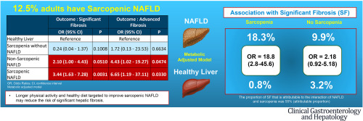
Sarcopenia in MASLD Is Associated With Advanced Fibrosis
NHANES 2017-2018 (N=2,422)
NAFLD: TE w/o other CLD
  Significant=LS >8.0 kPa
  Advanced= >13.1 kPa
Sarcopenia by EWGSOP
12.5% of adults have sarcopenic NAFLD
Sarcopenic NAFLD was associated with advanced fibrosis
Association independent of demographics, socioeconomic status, and metabolic characteristics.
Increased leisure time physical activity (>300 min/wk) is associated with a lower risk of sarcopenia.
NHANES 2017-2018 (N=2,422)
Harring M, Golabi P, Paik JM, Shah D, Racila A, Cable R, Srishord M, Younossi ZM.. Clin Gastroenterol Hepatol. 2023 Oct;21(11):2876-2888.e5..

Slide 26
Awareness Challenges: Knowledge Gaps
Patient level: Using NHANES data, only 4.4% NAFLD patients were aware of having liver disease vs. 37.8% of viral hepatitis
AlQahtani, Younossi Z Hepatology Communication 2021
Policy level Data from 102 countries (86% of the world population), on NAFLD policies, guidelines, civil society engagement, clinical management, and epidemiology.
1/3 of countries (n=32/102) scored 0 on PI
No country had national strategy
NAFLD rarely mentioned in the strategies of related conditions such as diabetes.
Only 32 countries had national guidelines
Provider level: Survey-Global NASH Council (54 and 59 Questions) of 2202 clinicians (HEP, GI, ENDO and PCP) from 40 countries
Younossi Z et al Clin Gastro Hepatol. 2021 3:S1542-3565(21)00719-9
Lazarus JV, et al. J Hepatol. 2021 ,Dec 8:S0168-8278(21)02168-1.

Slide 27
Identify Patients at Risk of Cirrhosis and Adverse Outcomes
Histologic Predictors of Outcomes
Systematic review and meta-analysis of 13 studies 4,428 NAFLD patients (2,875 with histological NASH).
Regression of Fibrosis Leads to Improvement of Clinical Outcomes
NASH cirrhosis (STELLAR-4 and Simtuzumab clinical trials)
Regression: Any reduction in fibrosis (NASH CRN or Ishak)
Liver-related events: Ascites, portal hypertension haemorrhage, HE, MELD >15, LT and death
In NASH-cirrhosis, regression was observed in 16% over 48 weeks
All-Cause Mortality
Fibrosis regression and liver-related events in NASH cirrhosis
Liver-Related Mortality
HR 0.16 (95% CI: 0.04, 0.65)
p=0.0104
HR 0.08 (95% CI: 0.02, 0.32)
p=0.0004
Liver related events (%)
Taylor RS, Taylor RJ, Bayliss S, Hagström H, Nasr P, Schattenberg JM, Ishigami M, Toyoda H, Wai-Sun Wong V, Peleg N, Shlomai A, Sebastiani G, Seko Y, Bhala N, Younossi ZM, Anstee QM, McPherson S, Newsome PN. Gastroenterology. 2020May;158(6):1611-1625
Sanyal AJ, et al. Hepatology. 2022 May;75(5):1235-1246..

Slide 28
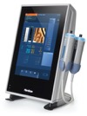
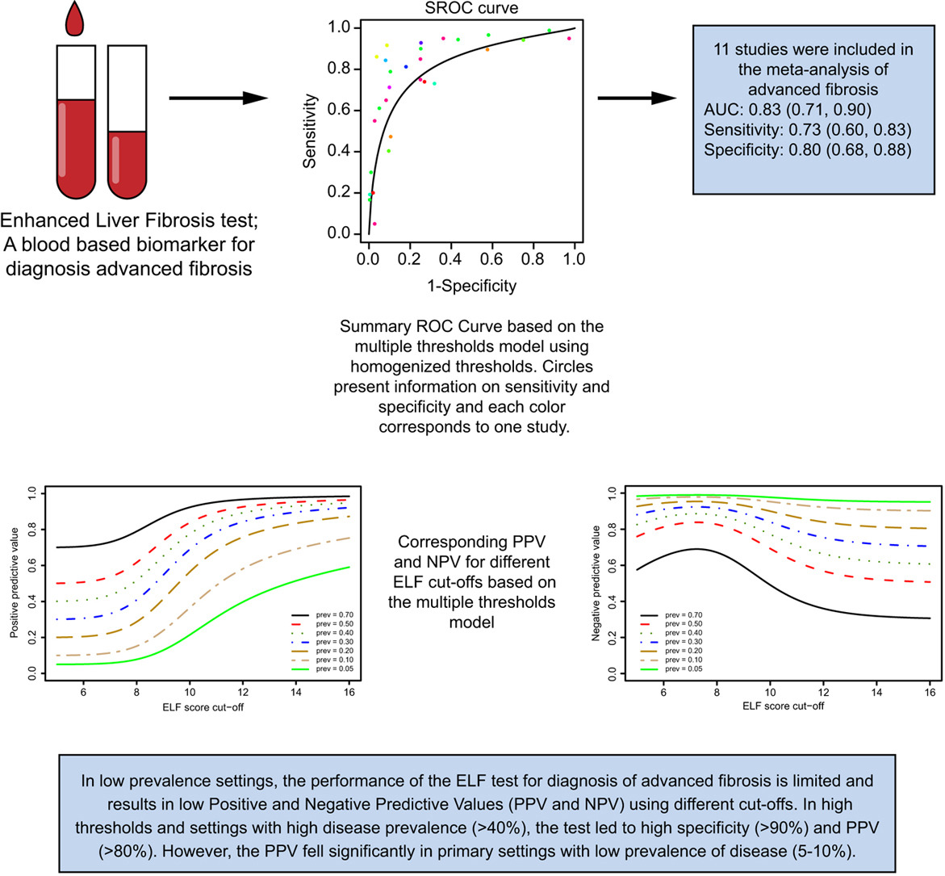
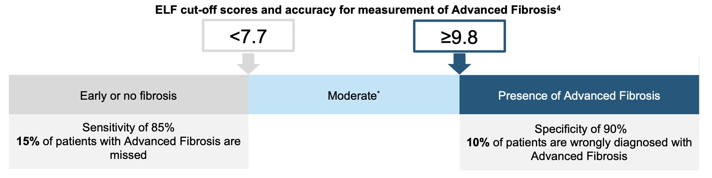
Identify Patients at Risk of Cirrhosis and Adverse Outcomes
Non-invasive Tests
Low Cutoff (NPV)
High Cutoff (PPV)
Low Probability of F3/4
Indeterminate
High Probability of F3/4
1.3
2.67
Liver stiffness
Stage | Threshold (kPa) | AUROC | Sensitivity | Specificity | PPV | NPV
F0-F1 vs > F2 | 8.2 | 0.77 | 0.71 | 0.70 | 0.78 | 0.61
F0-F2 vs > F3 | 9.7 | 0.80 | 0.71 | 0.75 | 0.63 | 0.81
F0-F3 vs F4 | 13.6 | 0.89 | 0.85 | 0.79 | 0.29 | 0.98
FAST: CAP+LSM+AST
Obtained through a VCTE measurement
Correlated to extent of fibrosis
CAP
0.35
Attention to LSM values
0.67
Quantification of ultrasound attenuation obtained in VCTE measurement
Correlated to liver steatosis
Sterling et al. Hepatology. 2006, Eddowes et al. Gastroenterology. 2019. Vali et al. J Hep. 2020; Day J et al. JALM. 2019, Newsome et al; Lancet Gastro Hep. 2020

Slide 29
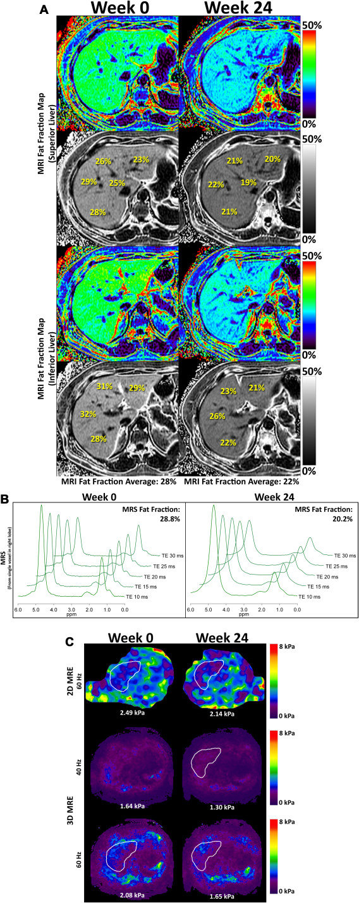
Identify Patients at Risk of Cirrhosis and Adverse Outcomes
Non-invasive Tests
Modified phase-contrast pulse sequence to visualize rapidly propagating mechanical shear waves (~60 Hz)
Cutoff for Detecting Advanced Fibrosis | Sensitivity (95%CI) | Specificity (95%CI) | PPV (95%CI) | NPV (95%CI)
MRE stiffness ≥ 3.64 kPa | 0.86 (0.65-0.97) | 0.91 (0.83-0.96) | 0.68 (0.48-0.84) | 0.97 (0.91-0.99)
Noureddin. Hepatology. 2013, Loomba. Hepatology. 2015, Loomba Hepatology. 2014; Patel et al. Ther Adv Gastroenterol. 2016; Han, Noureddin. Liver Int. 2020..

Slide 30
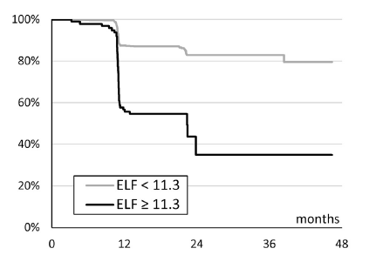
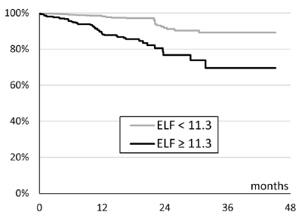
NITs Predicting Outcomes
FIB-4
VCTE
ELF
MRE
Longitudinal cohort study of 20,433 patients to evaluate the association of 12-month changes in FIB-4 with risk of developing severe NASH-related clinical events
UK Clinical Practice Research Datalink linked with Hospital Episodes Statistics and Office for National Statistics data (2001–2020)
Change in FIB-4 calculated from baseline to 12 m
4192 adults NHANES (2017–2018)
CAP (aHR: 1.01, 95% CI: 1.0–1.05), and LSM (aHR: 1.06, 95% CI: 1.02 1.11) associated with overall mortality.
NAFLD by CAP ≥ 285 had a 2.2-fold (95% CI: 1.0–4.7) increased odds of mortality
Cumulative mortality rates were significantly higher in participants with LSM of 9.7–13.5 (advanced fibrosis) and LSM ≥ 13.6 (cirrhosis)
Combined data from 4 clinical trials of SEL/SIM
N = 2154 with advanced NASH
47.5% F3, 52.5% F4
72% had diabetes
60% Female, 40%, Male
Mean follow-up = 16 months
The study included 320 NAFLD patients with MRE.
Threshold for distinguishing
-cirrhosis from NC: 4.39 kPa
-DCC: 6.48 kPa
-DCC odds with LS increase
(OR 3.28) (P < .001).
Baseline FIB-4 risk category
12-month FIB-4 change
F3
High
(>2.67)
Indeterminate
(1.30–2.67)
Low
(<1.30)
Increase
Decrease
HR = 2.48 (P <0.0001)
Cumulative incidence for:
All with high baseline FIB-4: 12.8%
FIB-4 increase: 18.5%
FIB-4 decrease: 10.1%
18.5%
Event-free survival: patients with F3 (bridging) fibrosis
Higher risk with
increasing FIB-4
Risk (%)
10.1%
F4
4.3%
3.3%
1.7%
HR = 2.83 (P <0.0001)
1.2%
Years of follow-up
Anstee Q, et al. AASLD 2022. Late-breaking poster #5049.
Vilar-Gomez E et al. Hepatology. 2023 Apr 1;77(4):1241-1252
Younossi ZM, et al. Gastro 2021;160:1608-19
Han MAT, Liver Int. 202040(9):2242-51.
30

Slide 31
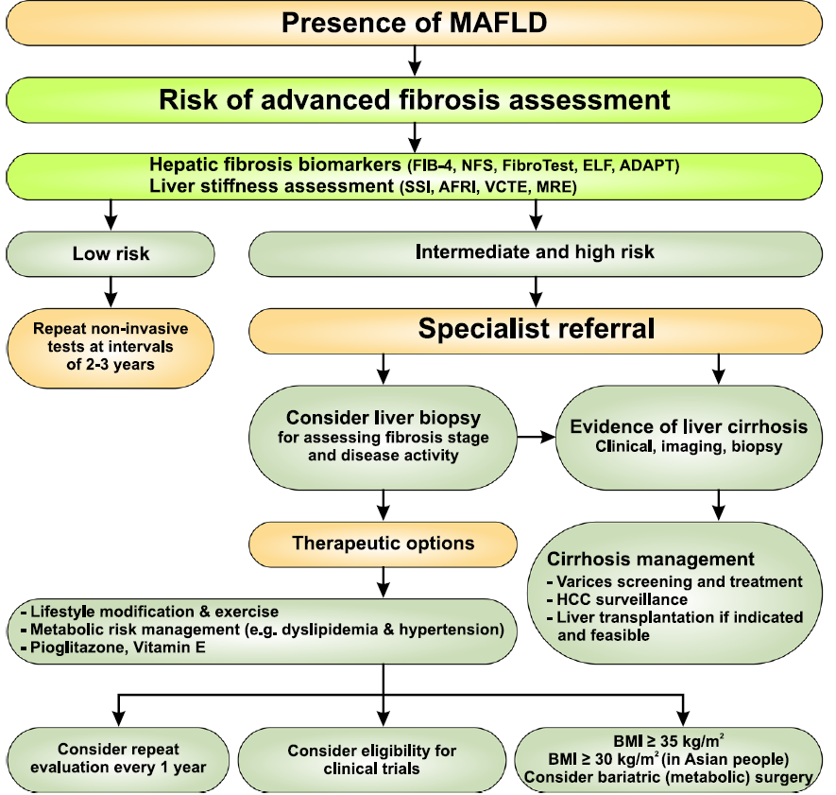
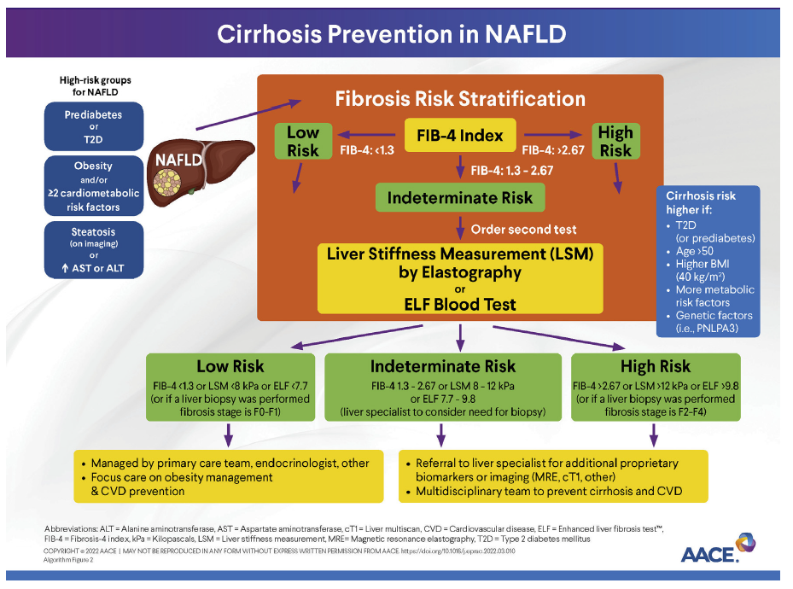
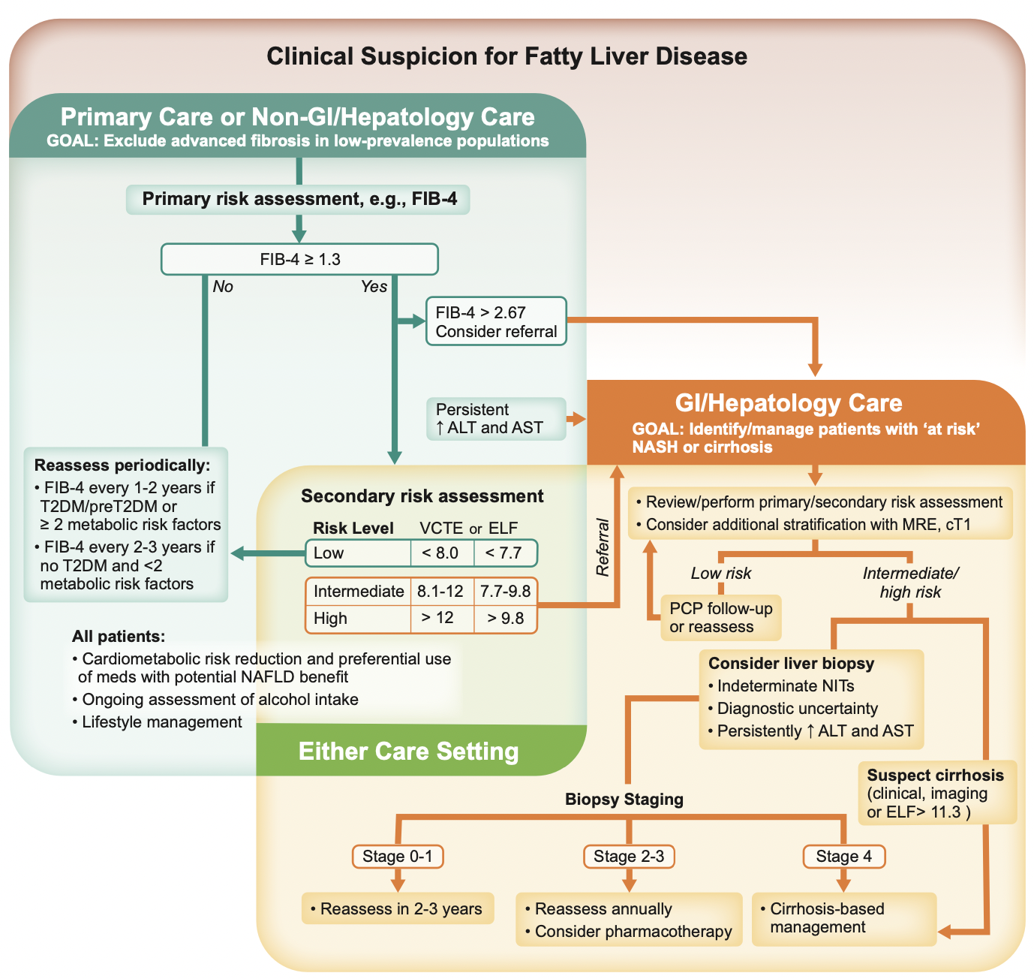
The Use of Common NITs in Guidelines
APASL 2020
AACE 2022
AASLD 2023
EASL 2024
Eslam M Hepatology International 2020, Cusi K et al. Diabetes Care 2022,Rinella M et al. Hepatology 2023, EASL/EASD/EASO J. of Hepatology 2024

Slide 32
The Use of Common NITs Consensus Recommendation
Younossi Z. et al. 2024

Slide 33
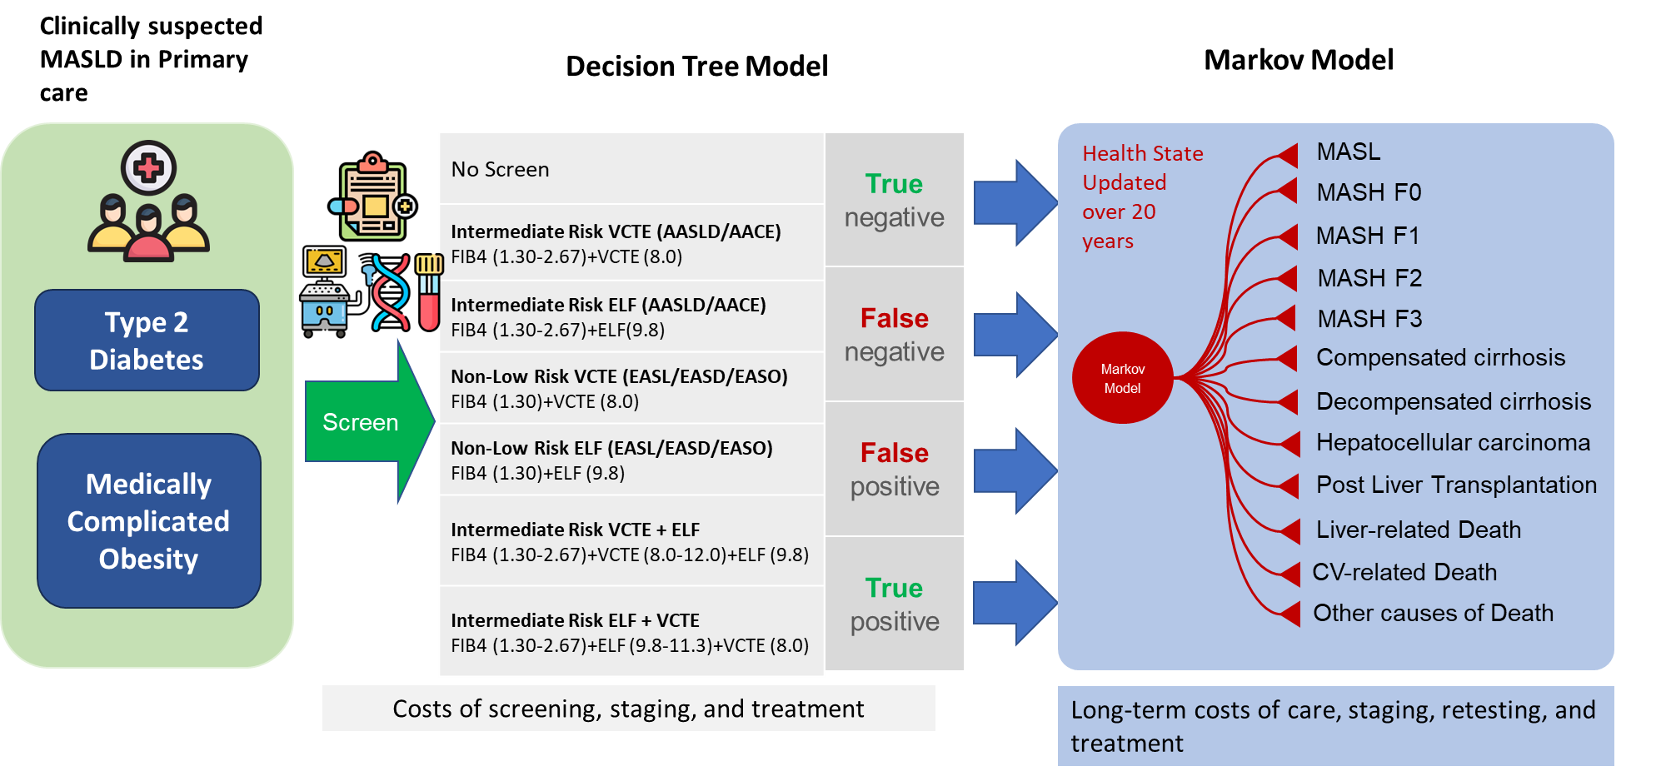
Reducing Disease Burden
Are Risk Stratification Algorithms Cost-Effective?
Younossi Z et al. Liver International 2024
Notes:
Cost of Inaction for Metabolic Dysfunction Associated Steatohepatitis (MASH): The Projected Economic Burden in the United States, Germany, Spain, Japan, Saudi Arabia and Brazil

Slide 34
Reducing Disease Burden
Is Risk Stratification Cost-Effective?
All screening strategies for high-risk MASLD in U.S. PCP incurred additional costs compared to no-screening ($13,587 to $14,730 ppt with T2D and $14,274 to $15,661 per patient with obesity.
However, screening reduced long-term costs, ranging from $22,150 to $22,279 ppt with T2D and $13,704 to $13,705 per with obesity, compared to $24,221 and $14,956 for no screening
ICERs for these strategies ranged from $26,913 to $27,884 per QALY for T2D patients and $23,265 to $24,992 per QALY for patients with obesity.
 | Total Cost | QALYs | ICER
No Screen | $24,515 | 6.0185 | Ref
Intermediate Risk VCTE (AASLD/AACE) | $38,293 | 6.5304 | $26,913
Intermediate Risk ELF (AASLD/AACE) | $38,102 | 6.5259 | $26,779
Non-Low Risk VCTE (EASL | $38,513 | 6.5348 | $27,112
Non-Low Risk ELF (EASL) | $38,305 | 6.5297 | $26,977
Intermediate Risk VCTE + ELF | $39,188 | 6.5472 | $27,750
Intermediate Risk ELF + VCTE | $39,245 | 6.5475 | $27,844
 | Total Cost | QALYs | ICER
No Screen | $15,264 | 8.4766 | Ref
Intermediate Risk VCTE (AASLD/AACE) | $29,774 | 9.0928 | $23,545
Intermediate Risk ELF (AASLD/AACE) | $29,538 | 9.0901 | $23,265
Non-Low Risk VCTE (EASL) | $30,052 | 9.0955 | $23,892
Non-Low Risk ELF (EASL) | $29,791 | 9.0924 | $23,588
Intermediate Risk VCTE + ELF | $30,863 | 9.103 | $24,900
Intermediate Risk ELF + VCTE | $30,925 | 9.1032 | $24,992
Base Case T2D
Base Case Obese
ICERs were affected by the availability of VCTE in PCP but remained cost-effective when using ELF as the second line test.
Younossi Z et al. Liver International 2024
Notes:
)

Slide 35
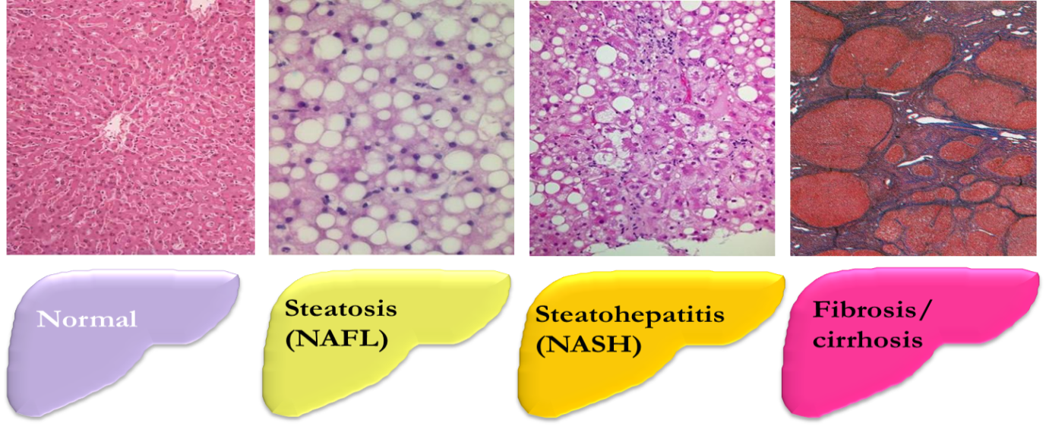
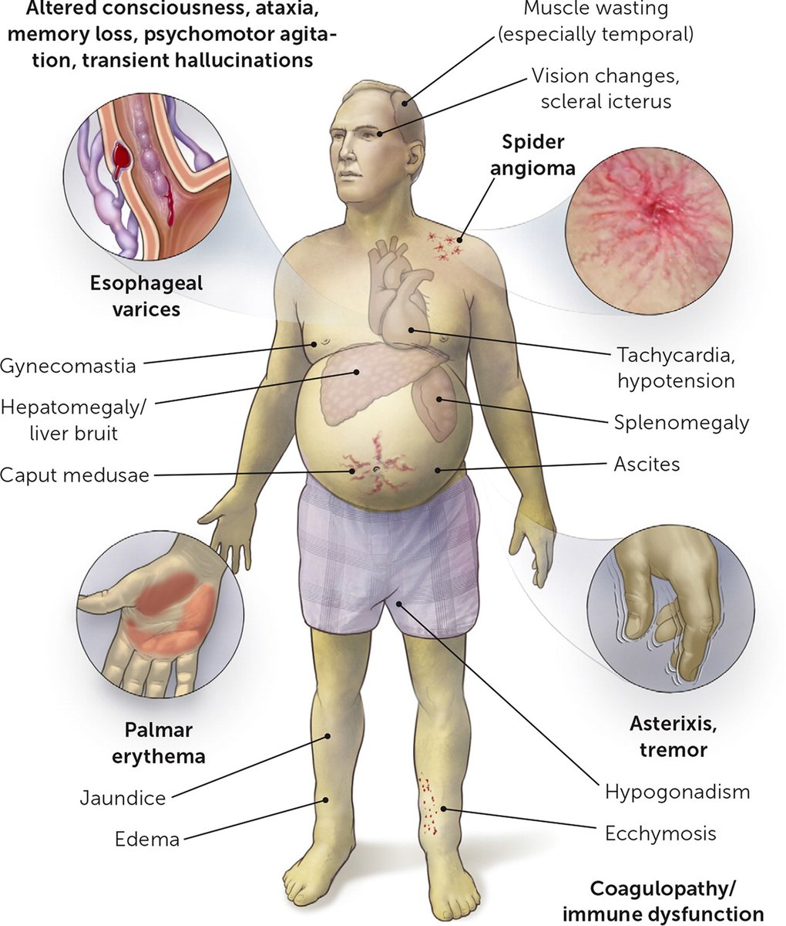
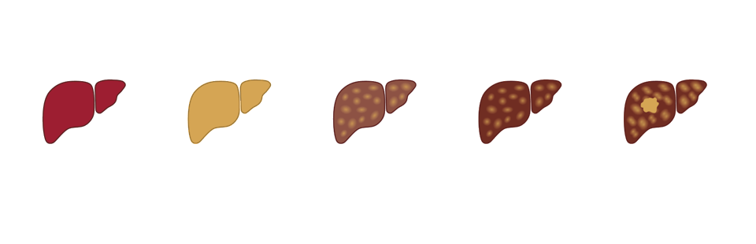
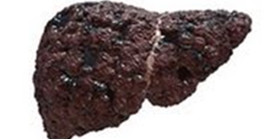
MASLD Target Population for Pharmacotherapy
Dynamic process
Normal
Steatosis
Steatohepatitis
(MASH)
Fibrosis/ cirrhosis
Foundation of Care
Life-style modification and weight loss
Outcome

Slide 36
Summary of Lifestyle Management in MASLD
Younossi Z et al. The Global Consensus Guideline 2024, EASL/EASD/EASO J of Hep 2024, Vilar-Gomez. Gastroenterology. 2015; 2. Promrat. Hepatology. 2010; 3. Harrison. Hepatology. 2009; 4. Wong. J Hepatol. 2013, Hashida et al. Journal of Hepatology. 2017. Research Article. CrossMark. EASL Journal of Hepatology Akhlaghi. J Diabet Met Dis. 2020;19:575, Liu et al. Plos One. 2015; Birerdinc A et al. Aliment Pharmacol Ther. 2011; Catalano D. Dig Dis Sci. 2010; Gutièrrez-Grobe Y et al. Ann Hepatol. 2012; Molloy JW et al. J Hepatol. 2012

Slide 37
MASLD Target Population for Pharmacotherapy
Dynamic process
Normal
Steatosis
Steatohepatitis
(MASH)
Fibrosis/ cirrhosis
Foundation of Care
Life-style modification and weight loss
Outcome
“At risk”
Target for Drug Therapy

Slide 38
Treatment of MASLD: Drugs to Treat Cardio-metabolic Risks
European Association for the Study of the Liver (EASL)*, European Association for the Study of Diabetes (EASD), European Association for the Study of Obesity (EASO). J of Hepatology, July 2024.

Slide 39
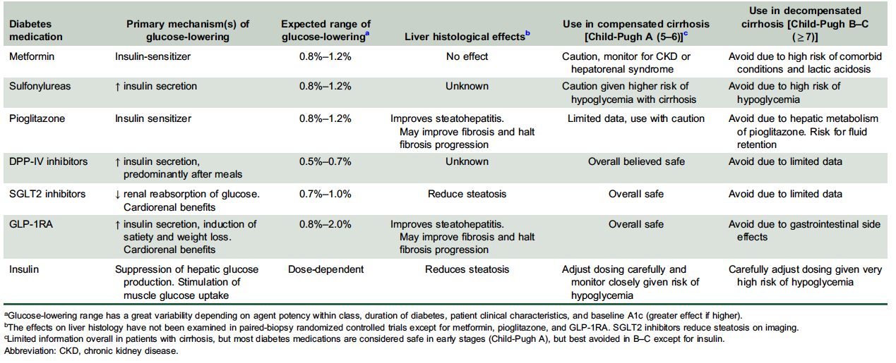
Treatment of MASLD: Drugs to Treat Cardio-metabolic Risks
Castera L, Cusi K. Hepatology. 2023;77:2128-2146.

Slide 40
Common Anti-diabetic Medications for NASH
Peroxisome Proliferator-Activated Receptors (PPARγ) Agonist (Pioglitazone)
N=101 NASH with pre-DM or DM.
All participants were placed on a 500 kcal/d deficit diet and randomized to placebo or pioglitazone 30 mg/day (titrated to 45 mg/d after 2 months) for 18 months.
Cusi K, et al. Ann Intern Med. 2016;165(5):305-315.
Cusi K, et al. Ann Intern Med. 2016;165(5):305-315.
Musso G, et al. JAMA Intern Med. 2017;177(5):633-640.

Slide 41
Treatment of MASLD: Drugs to Treat Cardio-metabolic Risks
European Association for the Study of the Liver (EASL)*, European Association for the Study of Diabetes (EASD), European Association for the Study of Obesity (EASO). J of Hepatology, July 2024.

Slide 42
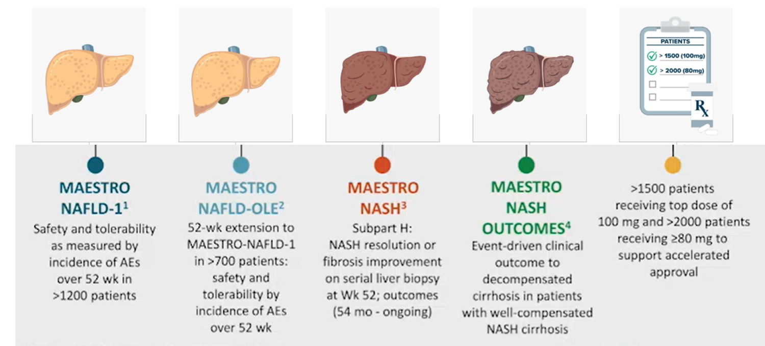
US FDA Approves Resmetirom (March 14, 2024)
Resmetirom Registration Trials
MAESTRO
NAFLD-1¹
MAESTRO
NAFLD-OLE²
MAESTRO
NASH³
MAESTRO
NASH OUTCOMES⁴
>1500 patients
receiving top dose of
100 mg and >2000 patients
receiving ≥80 mg to
support accelerated
approval
Safety and tolerability
as measured by
incidence of AEs
over 52 wk in
>1200 patients
52-wk extension to
MAESTRO-NAFLD-1
in >700 patients:
safety and
tolerability by
incidence of AEs
over 52 wk
Subpart H:
NASH resolution or
fibrosis improvement
on serial liver biopsy
at Wk 52; outcomes
(54 mo – ongoing)
Event-driven clinical
outcome to
decompensated
cirrhosis in patients
with well-compensated
NASH cirrhosis

Slide 43
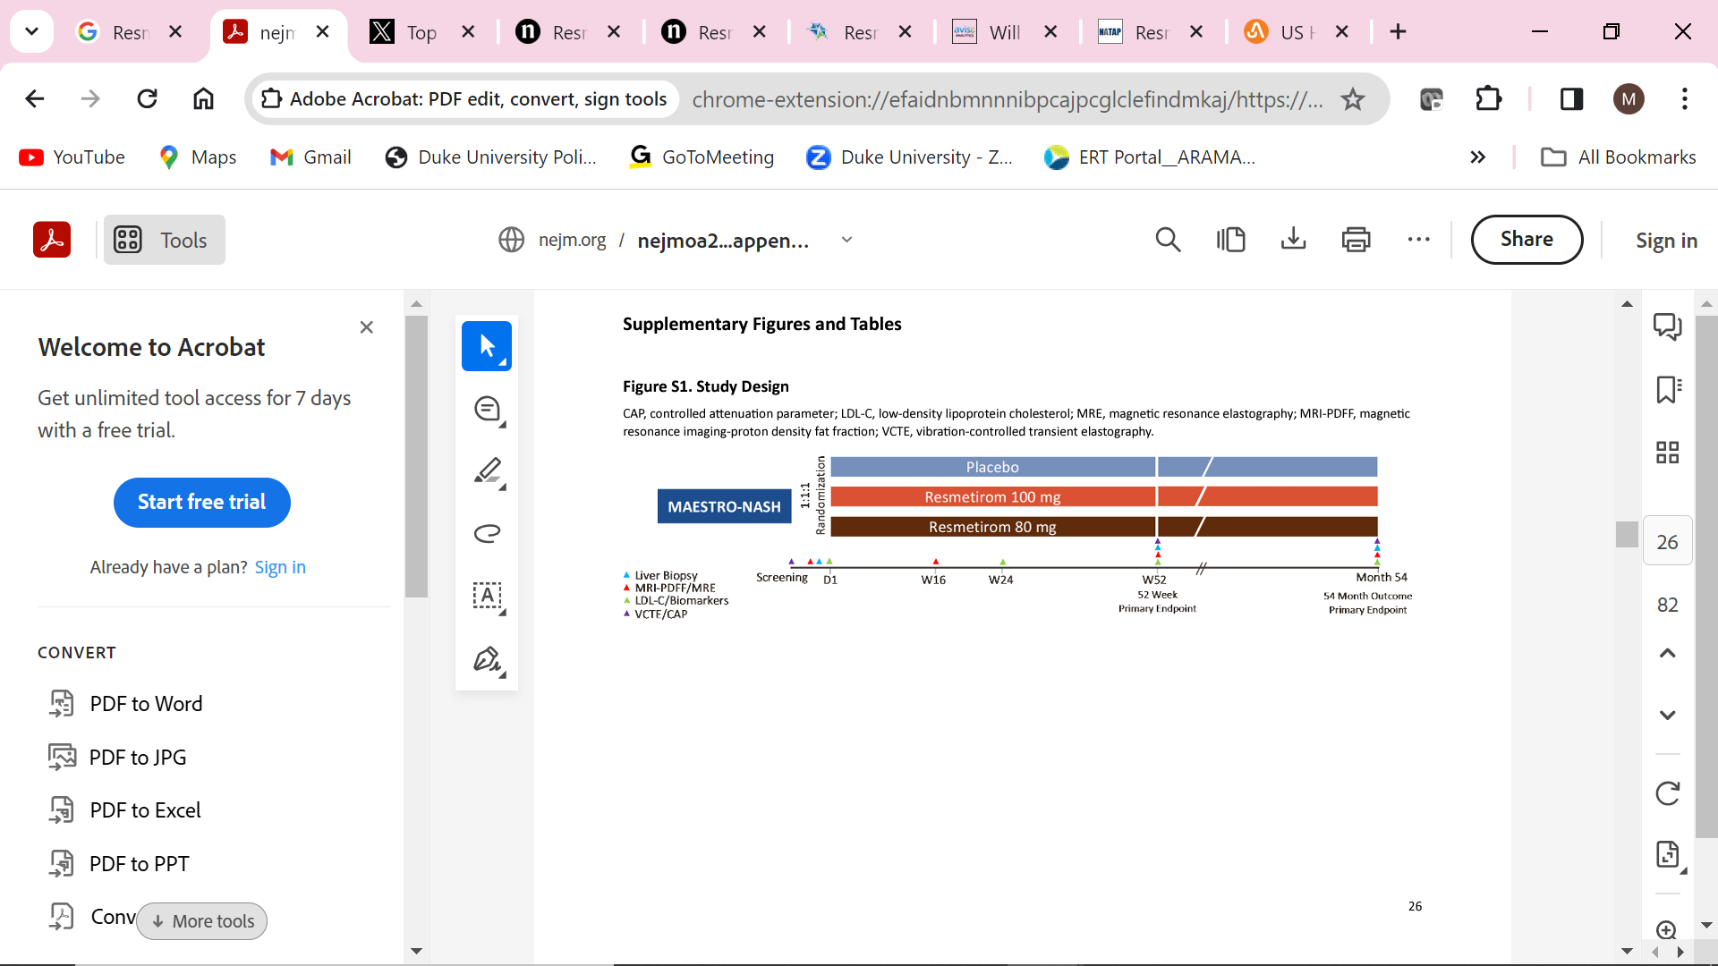
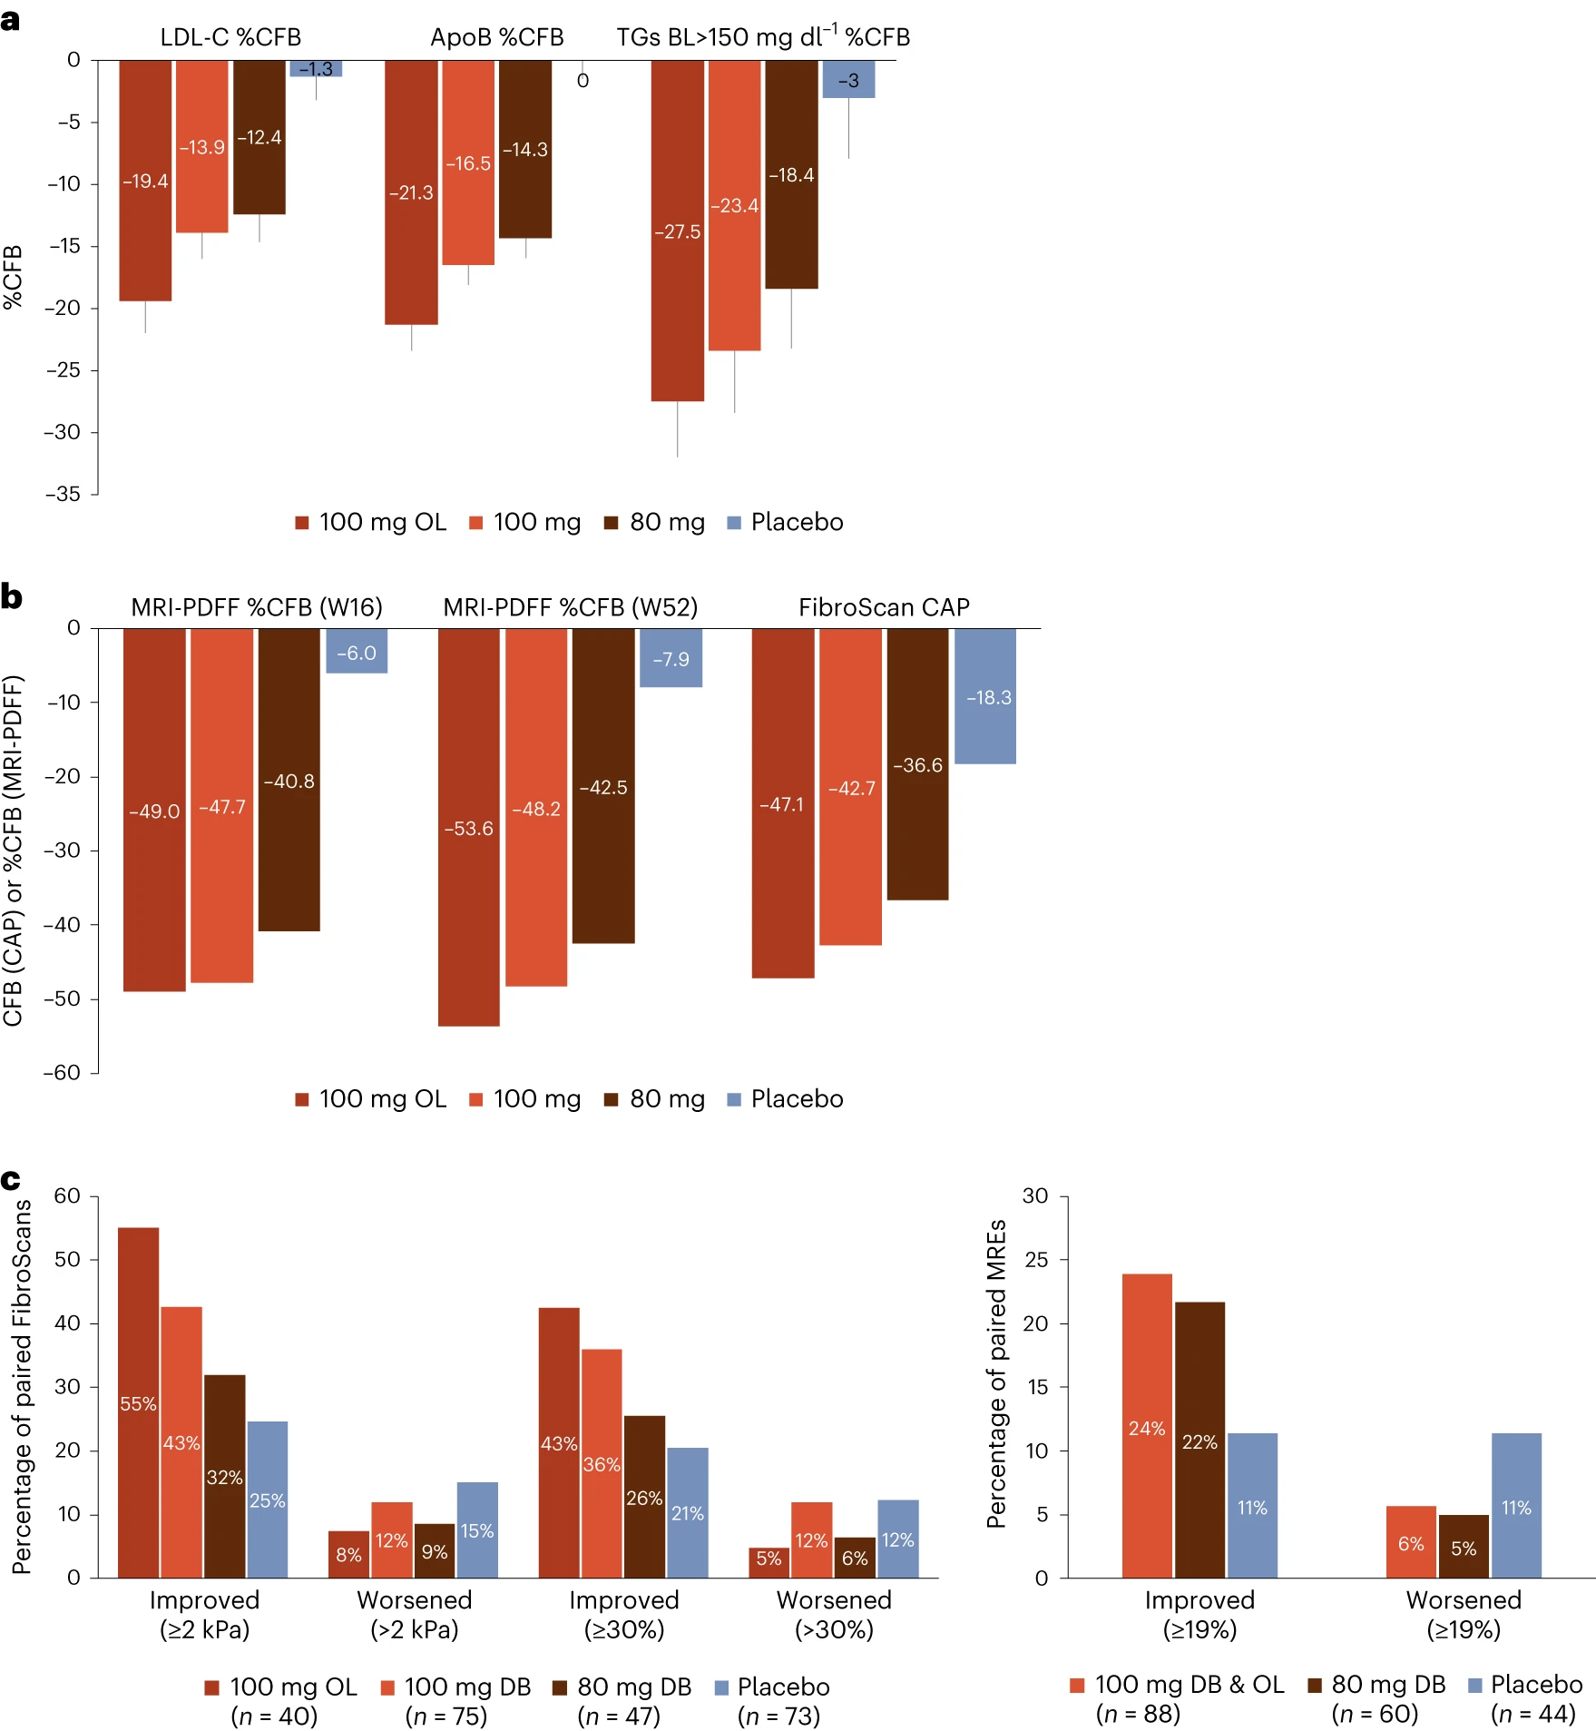
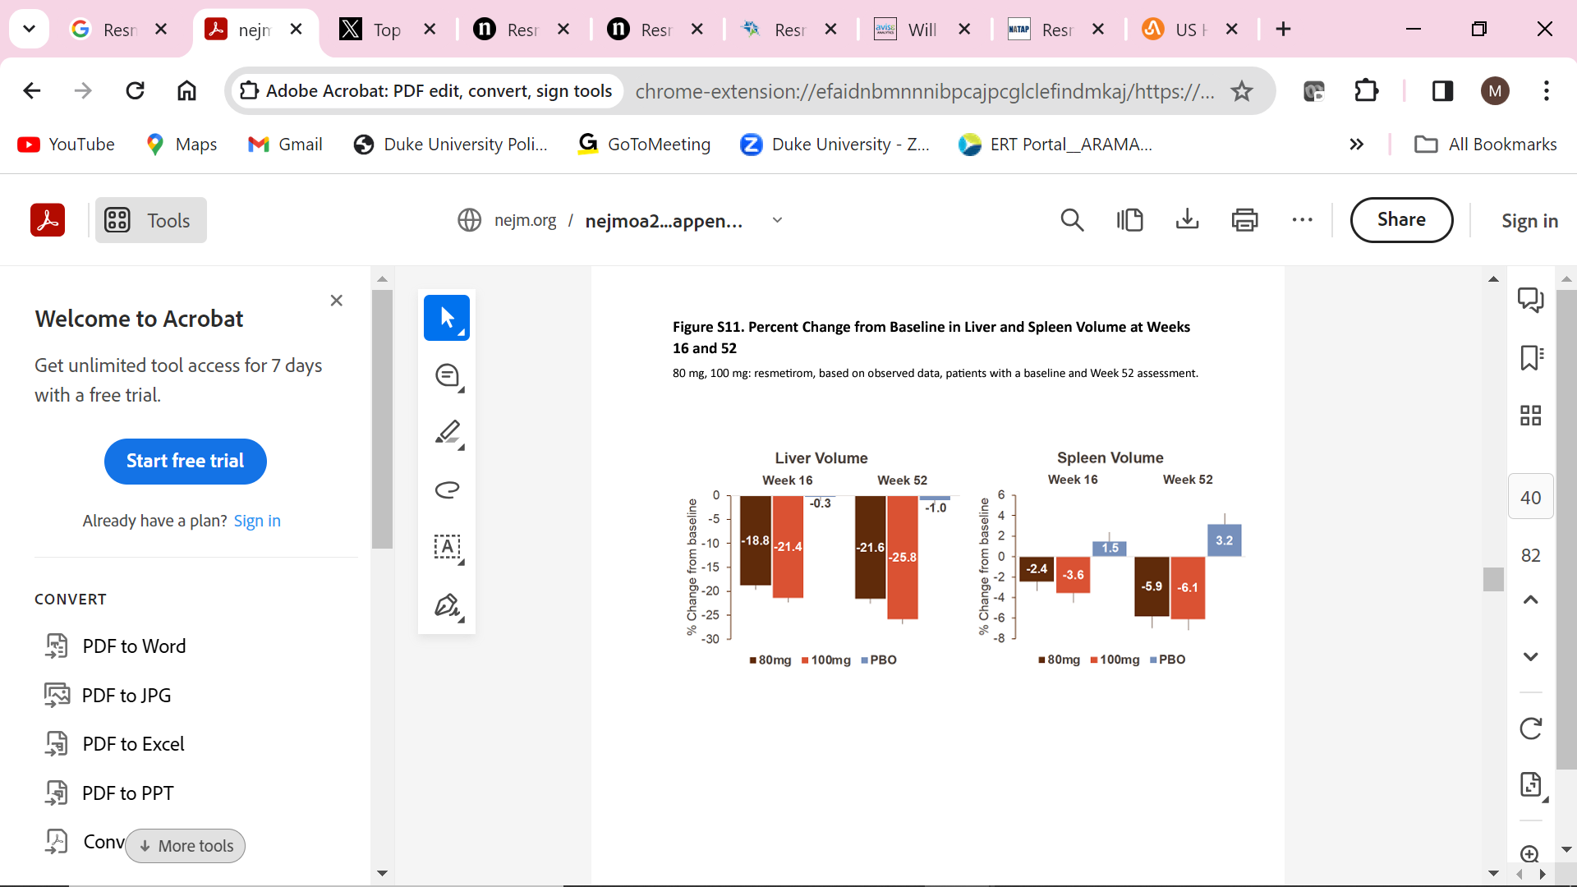
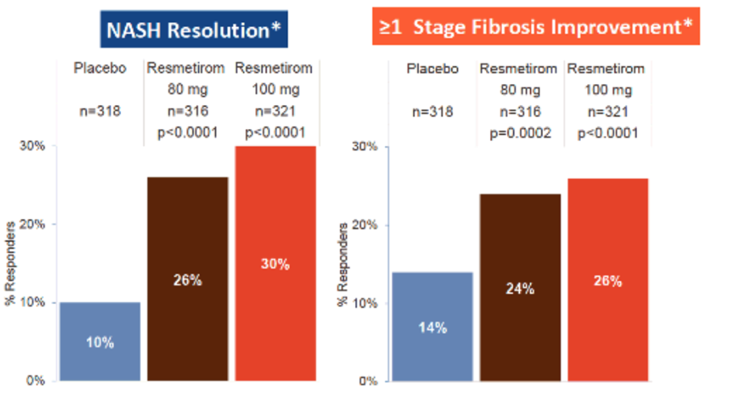
Resmetirom for MASH
Harrison S et al. NEJM. 2024.

Slide 44
Efficacy Among Subgroups of MASH and Fibrosis Treated With Resmetirom
NASH Resolution
Fibrosis Improvement
Common Adverse Reactions
Female 100 mg (n=180)
Female 100 mg (n=180)
Adverse Reaction | Placebo | Rezdiffra 80 mg Once Daily | Rezdiffra 100 mg Once Daily
 | N=294 | N=298 | N=296
Diarrhea | 52 (14) | 78 (23) | 98 (33)
Nausea | 36 (9) | 65 (18) | 51 (15)
Pruritus | 18 (4) | 24 (6) | 36 (10)
Vomiting | 15 (4) | 27 (7) | 30 (8)
Constipation | 18 (4) | 20 (5) | 28 (8)
Abdominal pain | 18 (4) | 22 (5) | 27 (7)
Dizziness | 6 (1) | 17 (4) | 17 (4)
Female 80 mg (n=179)
Female 80 mg (n=179)
Male 100 mg (n=141)
Male 100 mg (n=141)
Male 80 mg (n=137)
Male 80 mg (n=137)
F3 100 mg (n=207)
F3 100 mg (n=207)
F3 80 mg (n=195)
F3 80 mg (n=195)
F2 100 mg (n=99)
F2 100 mg (n=99)
F2 80 mg (n=105)
F2 80 mg (n=105)
No T2D 100 mg (n=109)
No T2D 100 mg (n=109)
No T2D 80 mg (96)
No T2D 80 mg (96)
T2D 100 mg (n=212)
T2D 100 mg (n=212)
T2D 80 mg (n=220)
T2D 80 mg (n=220)
Age ≥65 100 mg (n=84)
Age ≥65 100 mg (n=84)
Age ≥65 80 mg (n=70)
Age ≥65 80 mg (n=70)
Age <65 100 mg (n=237)
Age <65 100 mg (n=237)
Age <65 80 mg (n=246)
Age <65 80 mg (n=246)
NAS ≥6 100 mg (n=165)
NAS ≥6 100 mg (n=165)
NAS ≥6 80 mg (n=161)
NAS ≥6 80 mg (n=161)
NAS <6 100 mg (n=156)
NAS <6 100 mg (n=156)
NAS <6 80 mg (n=155)
NAS <6 80 mg (n=155)
-10
0
10
20
30
40
-10
0
10
20
30
40
% difference from placebo
% difference from placebo
Harrison S et al. EASL 2023. Oral presentation.

Slide 45
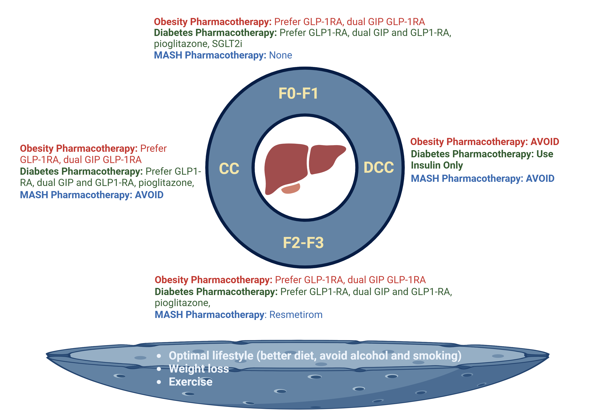
2024 Treatment of MASLD Based on Stage of Liver Disease: Obesity, T2D and MASH
Younossi Z 2024

Slide 46
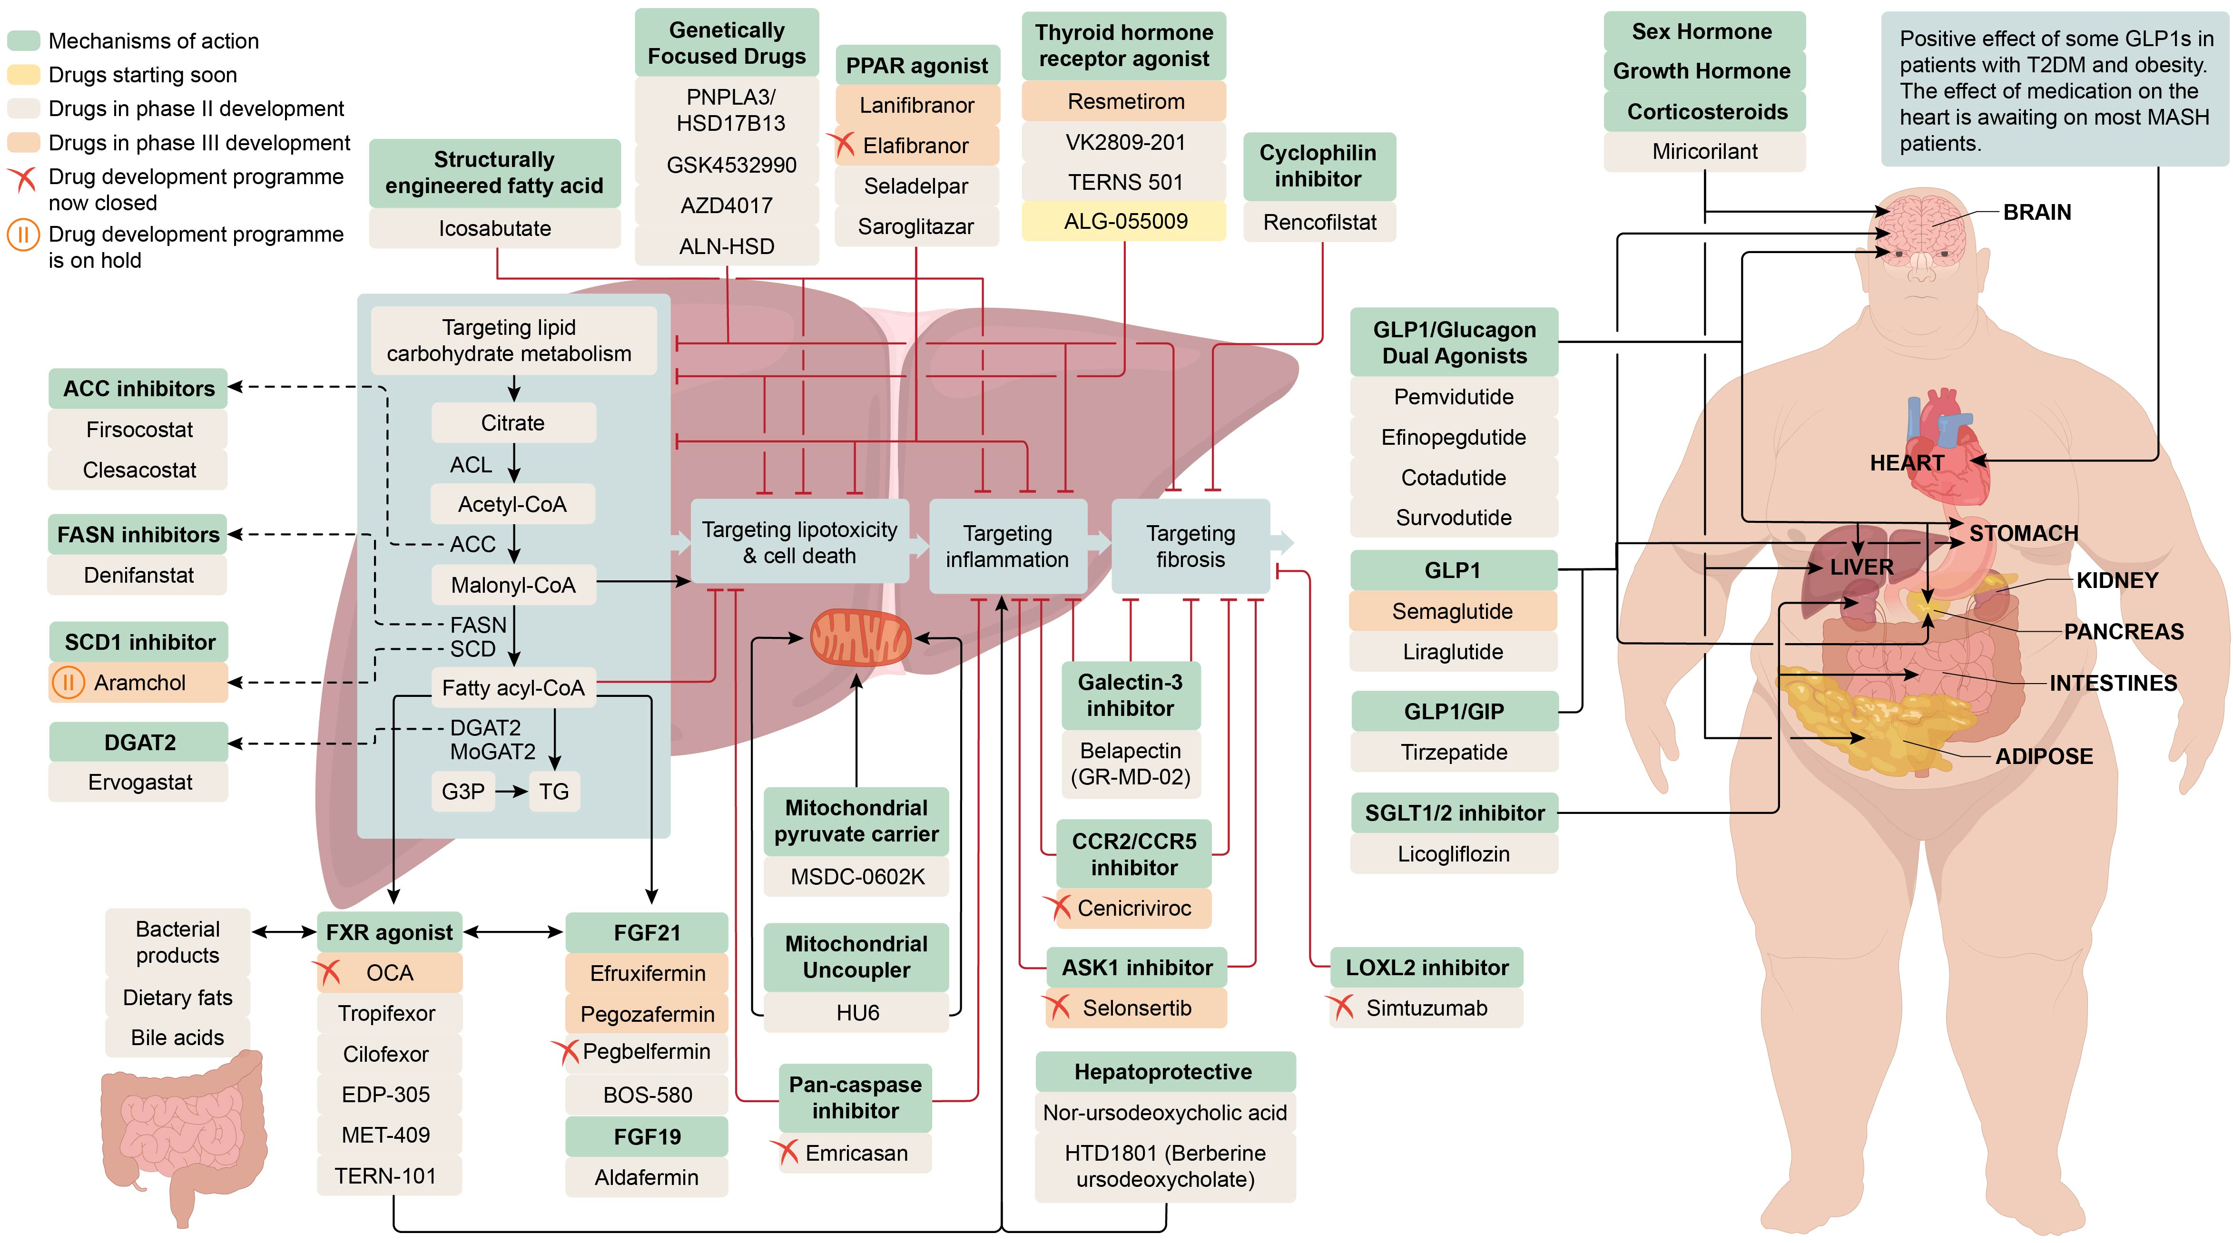
Future Potential Therapeutic Targets for MASH
Noureddin. Hepatology. 2023

Slide 47
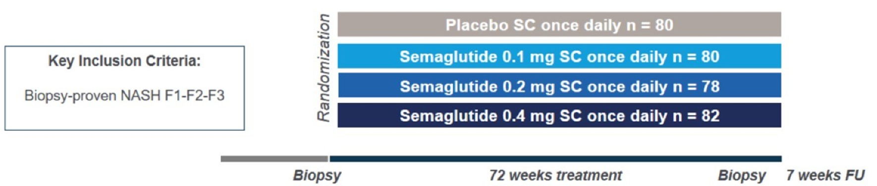
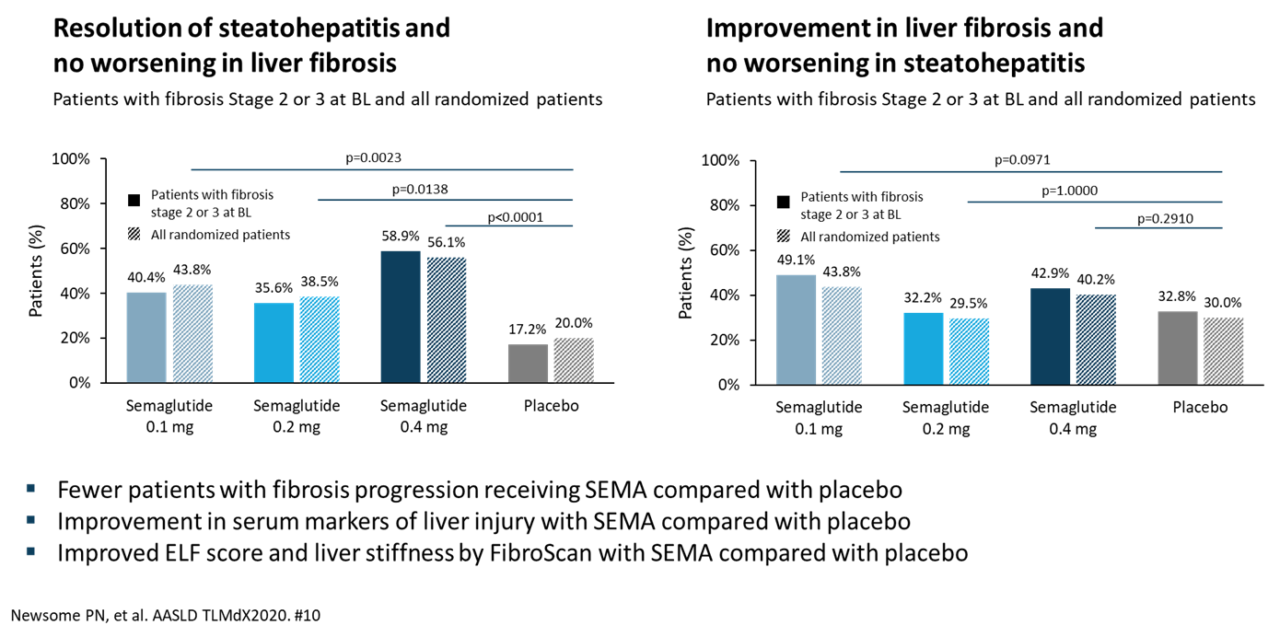
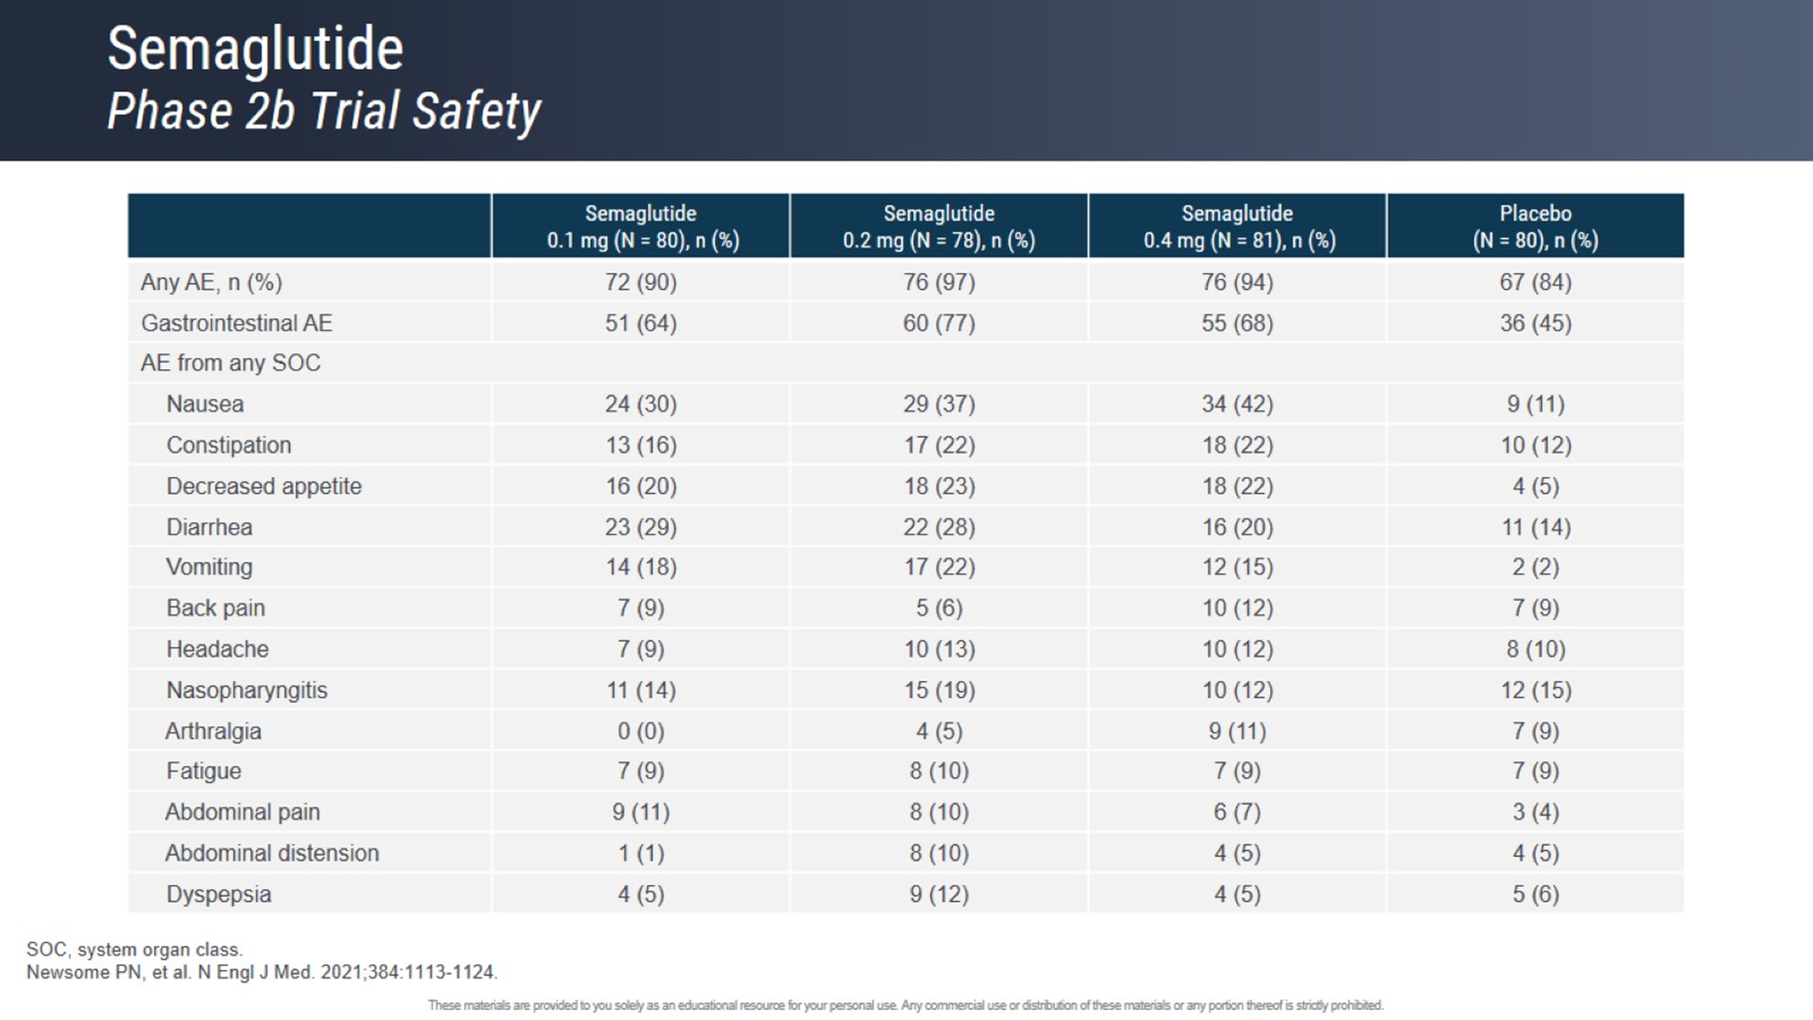
Phase 2 Clinical Trial of Semaglutide for Treatment of Patients with MASH
Not approved for MASH
Primary outcome: Resolution of NASH and no worsening in liver fibrosis
N=320 subjects
Improvement of NITs with active treatment
Newsome P et al. NEJM. 2021.

Slide 48
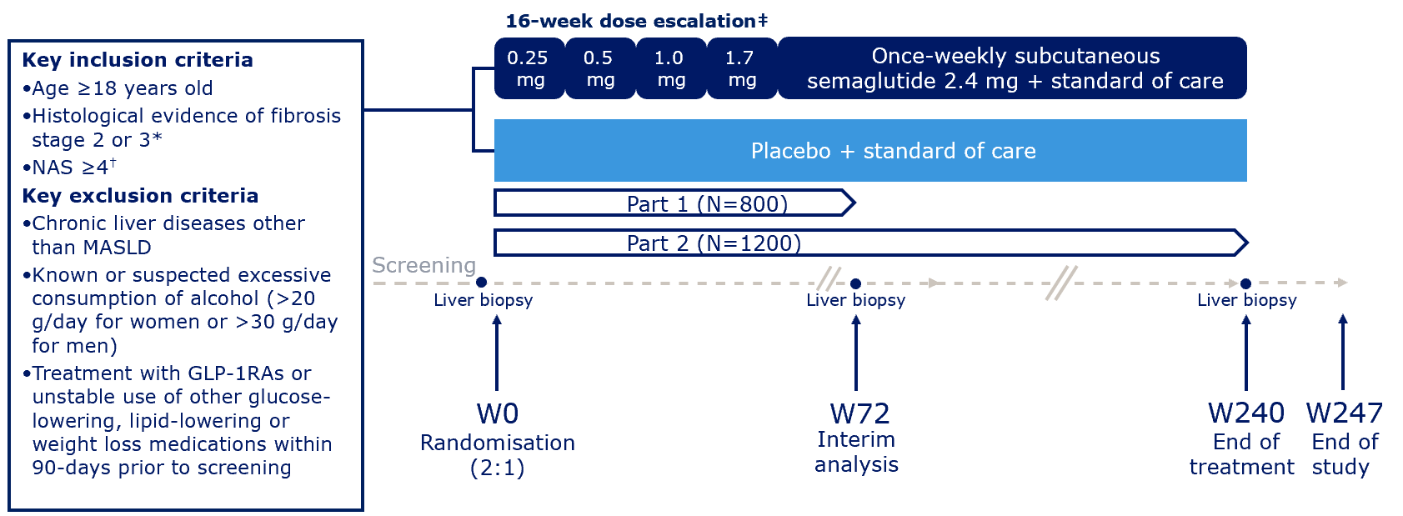
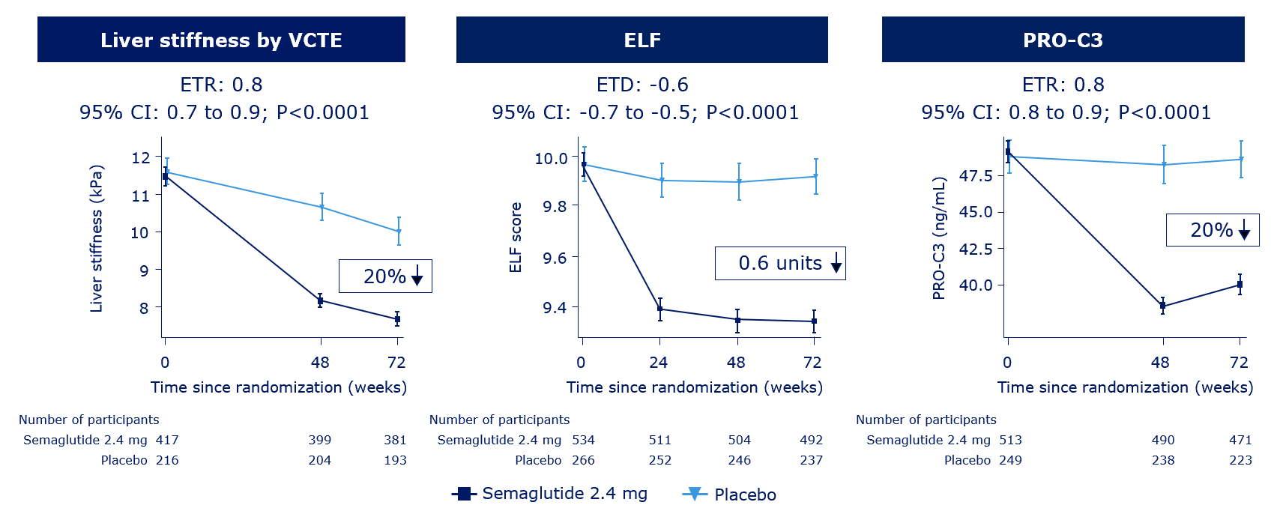
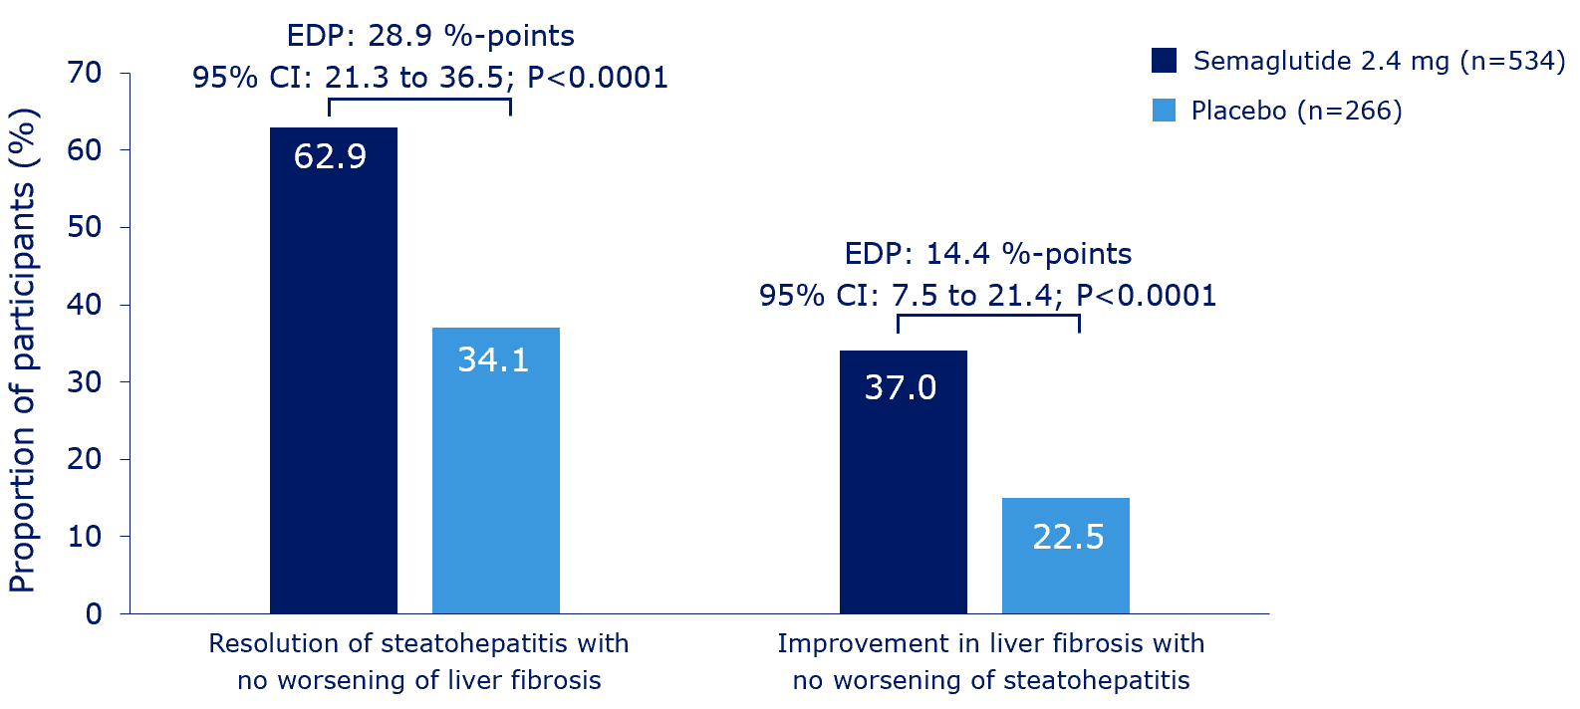
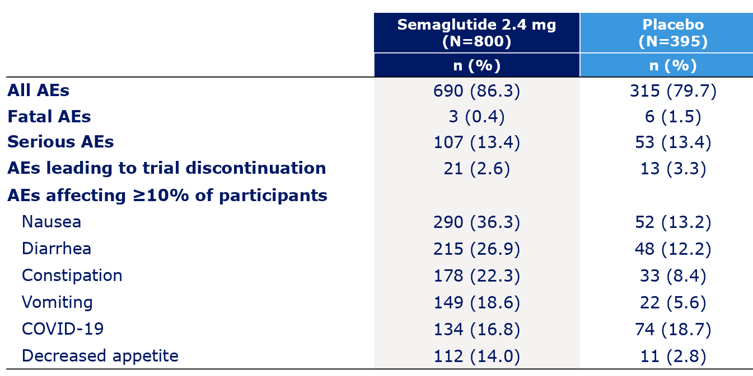
Phase 3 ESSENCE trial: Semaglutide in MASH
Primary endpoints

Slide 49
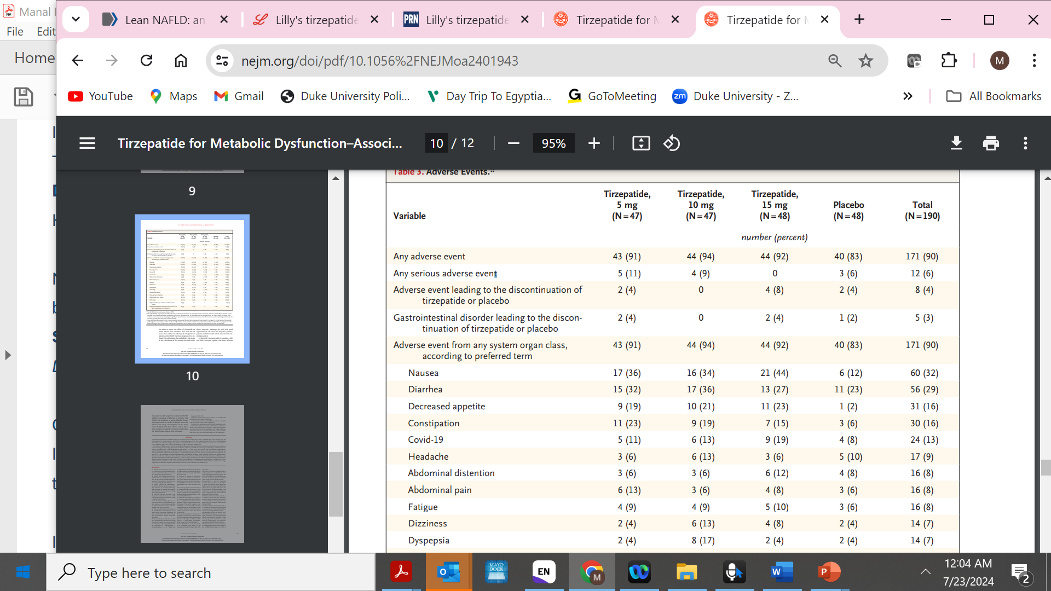
MASH and F2–F3 Fibrosis Treated with Tirzepatide for 52 Weeks—SYNERGY Study
Dual agonist-GLP-1 and GIP (Glucose dependent insulinotropic polypeptide)
Not approved for MASH
Key inclusion criteria
18–80 years of age
BMI ≥27 kg/m² and ≤50 kg/m² with or without T2D
Diagnosis of MASH, F2–3 fibrosis and NAS of ≥4
Resolution of MASH without Worsening of Fibrosis
At week 52
Improvement of NITs with active treatment
Loomba R et al. NEJM. 2024; Loomba R et al. EASL ILC 2024. LBO-001.
Notes:
dependent insulin

Slide 50
Survodutide (Glucagon and GLP-1 Receptor) Dual Agonist for MASH and Fibrosis: A Phase 2 Study
Not approved for MASH
Key inclusion criteria
18–80 years of age
NASH ≥4 with ≥ 1 point in
inflammation and ballooning
F1–3 fibrosis
MRI-PDFF ≥8%
FibroScan >6.0 kPa
BMI ≥25 kg/m²
Primary endpoint:
Histological improvement of MASH without worsening of fibrosis at Week 48
Sanyal AJ et al. NEJM. 2024; Sanyal AJ et al. EASL ILC 2024. GS-006.
Improvement of NITs with active treatment

Slide 51
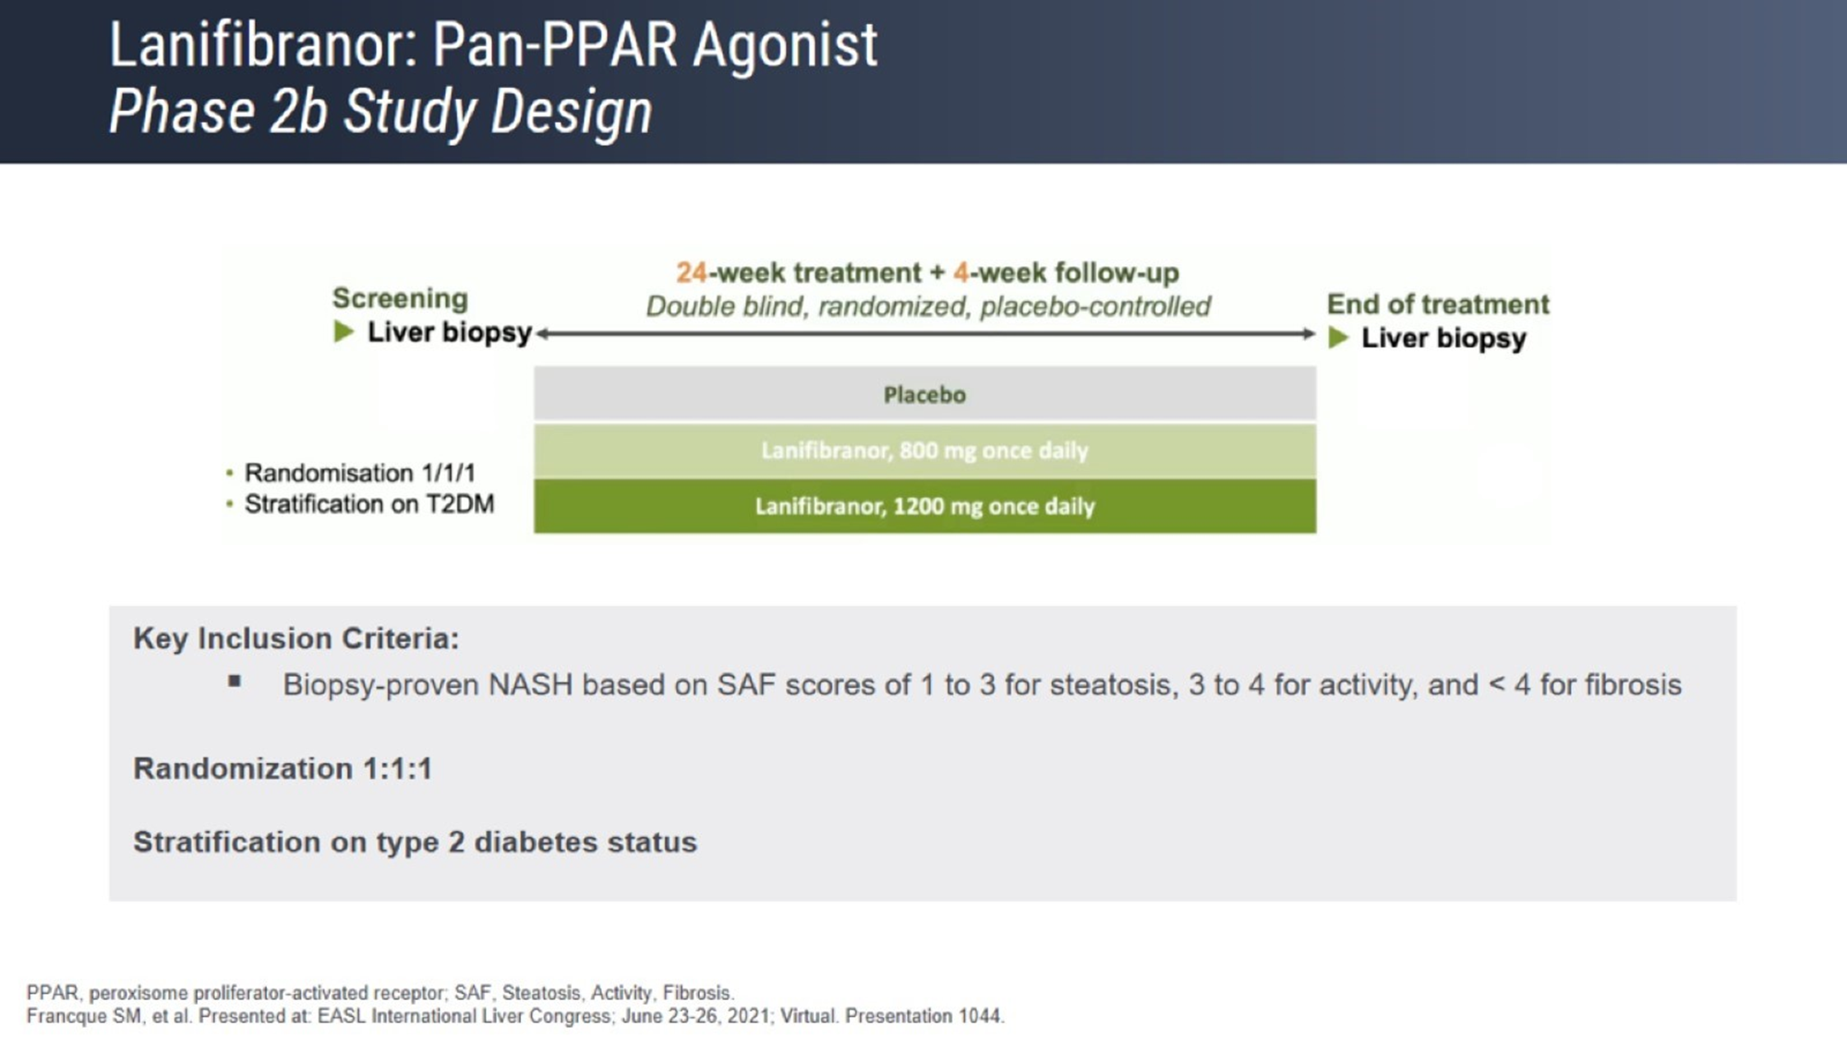
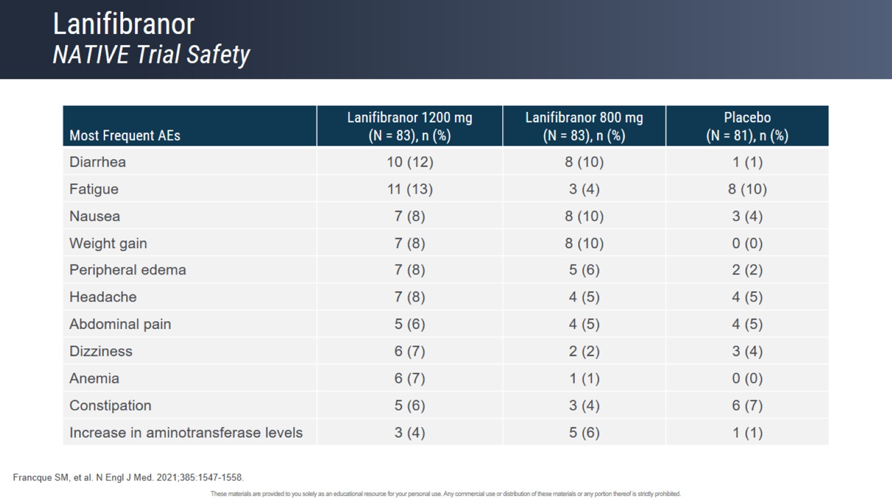
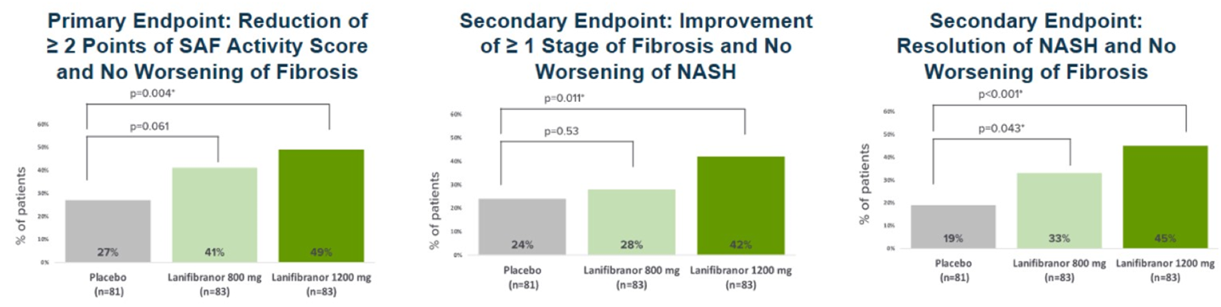
Lanifibranor: Pan-PPAR (PPAR α/δ/γ) Agonist
Franque S et al. NEJM. 2021.

Slide 52
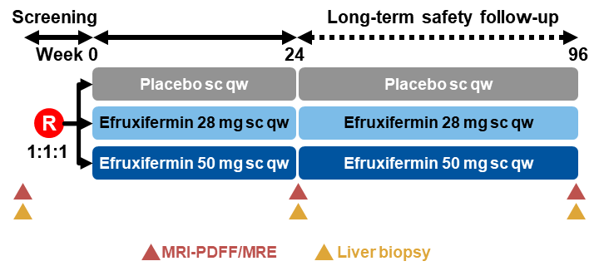
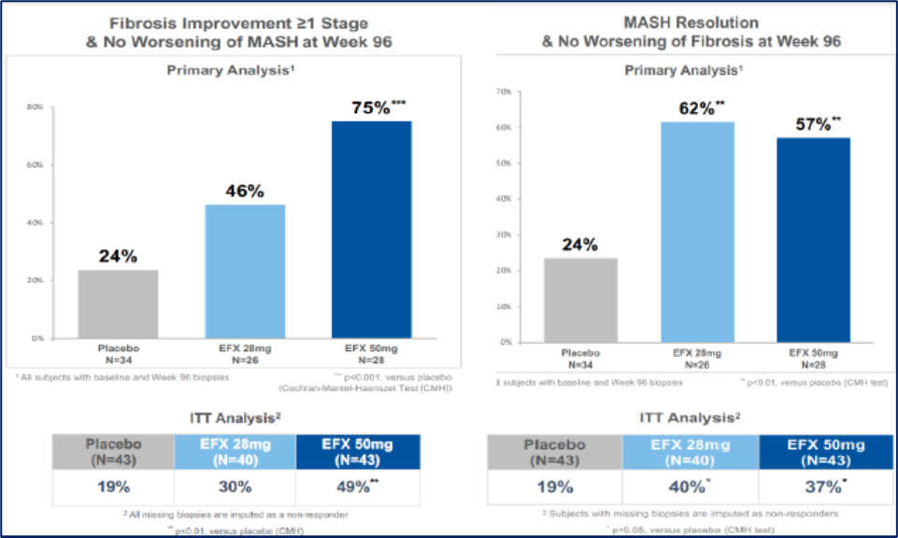
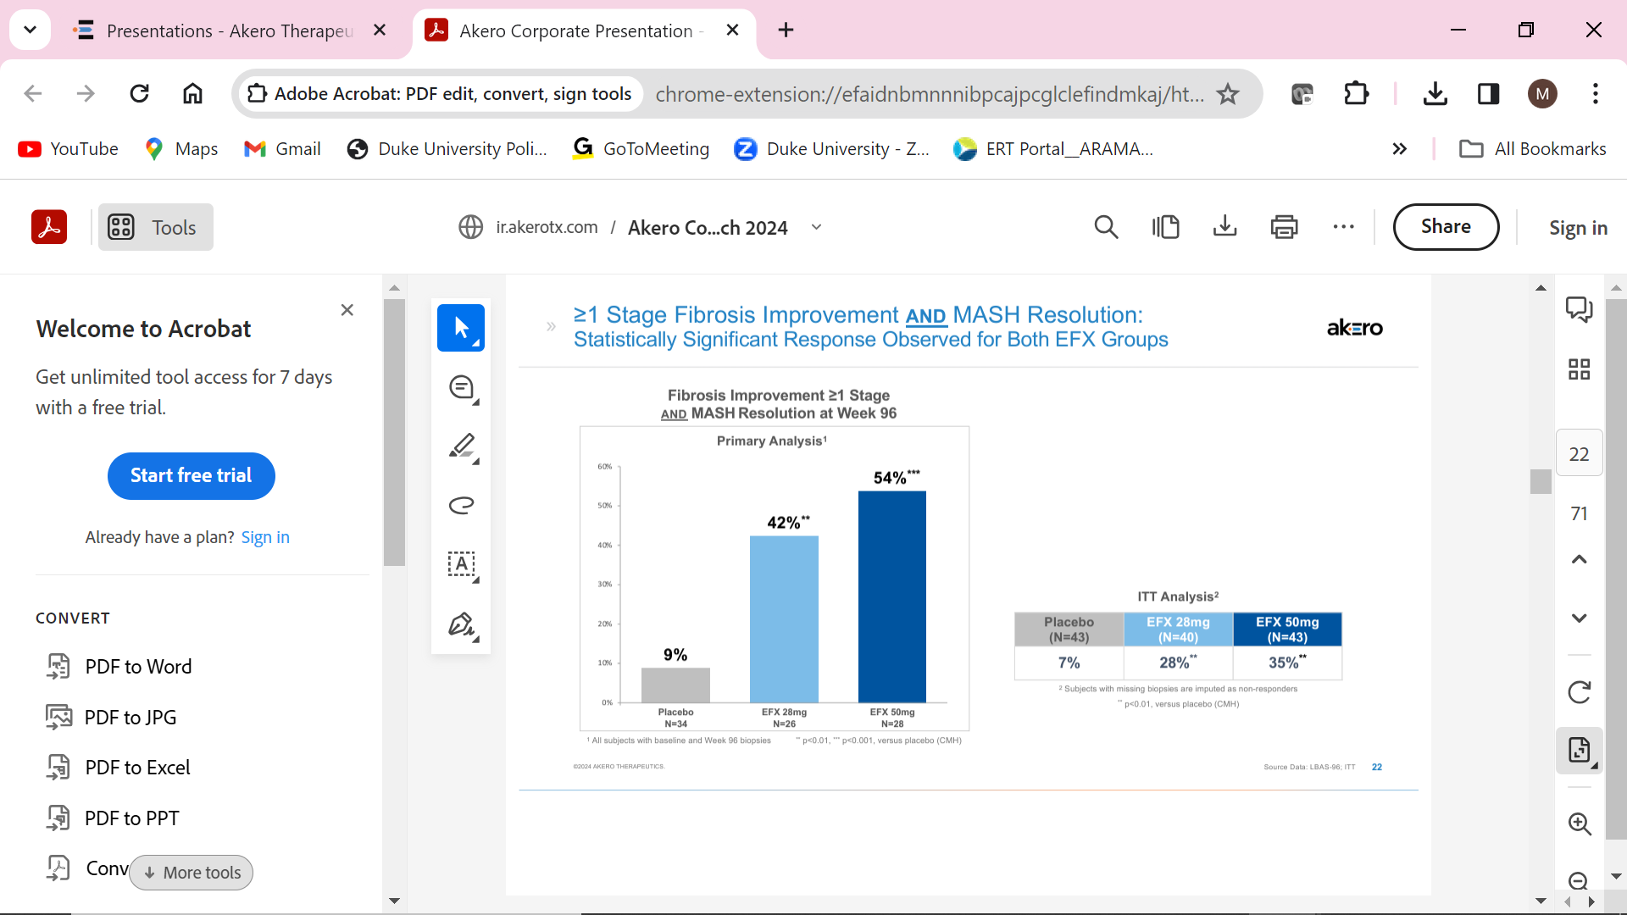
Efficacy of Efruxifermin (FGF21 Analogue) in MASH Phase 2b (HARMONY)
Not approved for MASH
TEAE Overview | Placebo (N=43) | EFX 28mg (N=40) | EFX 50mg (N=43)
TEAE Leading to Death | 0 (0%) | 0 (0%) | 0 (0%)
Drug-Related Serious Adverse Event (SAE) | 0 (0%) | 0 (0%) | 1 (2%)^{a,b}
Drug-Related TEAE Leading to Discontinuation | 0 (0%) | 2 (5%)^{c} | 2 (5%)^{d,e}
Most Frequent (≥15%) Drug-Related TEAEs | Placebo | EFX 28mg | EFX 50mg
Diarrhea | 6 (14%) | 14 (35%) | 14 (33%)
Nausea | 5 (12%) | 10 (25%) | 14 (33%)
Increased Appetite | 2 (5%) | 7 (18%) | 10 (23%)
Frequent Bowel Movements | 1 (2%) | 8 (20%) | 0 (0%)
Injection Site Erythema | 5 (12%) | 6 (15%) | 7 (16%)
Injection Site Bruising | 1 (2%) | 6 (15%) | 3 (7%)
Improvement of NITs with active treatment
Harrison S et al. Lancet Gastro & Hep. 2023.

Slide 53
Pegozafermin (FGF21 Analogue) in MASH Phase 2b (ENLIVEN Study)
Not approved for MASH
Key inclusion criteria
Aged 21–75 years
BMI ≥25 kg/m²
Biopsy-confirmed NASH
Fibrosis stage F2 or F3
NAS score ≥4
Score of ≥1 in each steatosis, ballooning degeneration, and lobular inflammation
Preferred term | Placebo (n=69) | 15 mg qw (n=21) | 30 mg qw (n=72) | 44 mg q2w (n=57)
Diarrhea | 3 | 24 | 17 | 9
Nausea | 1 | 14 | 21 | 18
Injection site erythema | 3 | 14 | 14 | 5
Injection site rash | 1 | 0 | 10 | 4
Increased appetite | 0 | 10 | 13 | 5
Drug-related AEs leading to discontinuation | 0 | 5ª | 6^{b} | 2^{c}
Drug-related SAEs | 0 | 0 | 0 | 2^{c}
Data are %; ªDiarrhea; ^{b}Diarrhea (n=2), nausea, ISR erythema; ^{c}Pancreatitis Unrelated discontinuations: Angina (placebo), Colon CA (30 mg qw); COVID-19 (30 mg qw)
Improvement of NITs (FAST, VCTE, PROC3 and ELF) with active treatment
Loomba et al. NEJM. Sept 2023. Loomba R et al. EASL ILC 2024. OS-118.

Slide 54


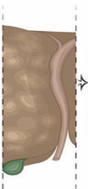

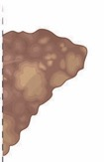
Clinical Trials of New Medications Future Combination Therapy for MASH and MASH Cirrhosis
Healthy Liver
Steatotic Liver
SLD with Fibrosis
Cirrhosis
HCC
Liver Disease Progression
Safety First
Risk Tolerance
Combination Therapy for Noncirrhotic MASH
Combination Therapy for Cirrhotic NASH
Agents with metabolic effects
Agents with antifibrotic effects
Notes:
The final slide is the combination future combination therapy of when to actually combine drugs and of course in the spectrum of disease progression from steatotic liver to fibrotic liver to cirrhosis and HCC. Of course HCC is not really a part of this, these clinical trials. So combination will be either with agents that will target metabolic targets versus those that will have anti-fibrotic effect and which combination we use is something that we could do in the future. Now one thing that's really important to emphasize that it's important not to confuse data from phase two clinical trial that suggests very high efficacy rate with those that only have phase three clinical trial. Phase threes go through the scrutiny of the clinical trial assessment and we know a lot of drugs that showed very promising result in phase two but did not make it in phase three. We just have to make sure that we are comparing apples to apples and that we are looking at appropriate endpoints before we suggest one drug that could be better than another drug. You can't really do this without side-to-side analysis of these drugs.​

Slide 55






Future Management of MASLD/MASH: Developing Integrated Care Pathways (Metabolic Clinic)
Multidisciplinary: hepatologist, endocrinologist, nutritionist
  Also psychologist, clinical pharmacist, physical therapist
Screen for “high Risk MASH”
Cardiovascular risk reduction is essential
  Manage dyslipidemia, diabetes, hypertension, smoking cessation, antiplatelet therapy
Screen and treat other comorbid conditions
  Obstructive sleep apnea, PCOS, degenerative joint disease
Integrative Weight Loss Centers
  Lifestyle interventions for all, obesity pharmacotherapy and/or endoscopic or bariatric surgery when appropriate
Individualized Pharmacotherapy for Pre-Diabetes and Diabetes
  Optimal glycemic control
Prevention strategies for those with advanced hepatic fibrosis
  Vaccination, screening and surveillance (varices / HCC).
DM
HTN
Lipids
Thyroid
Notes:
CV, cardiovascular; NAFLD, nonalcoholic fatty liver disease.
Philip N. Newsome, PhD, FRCPE: But what about the management of diabetes in these patients? Many of the patients whom I see who are referred up to hospitals with NASH will often have diabetes. You must therefore think, how do I best manage their diabetes given that I know they have NASH?
Well, I think NASH in many respects captures the need for “wholistic” medicine. So, while we’re treating their liver disease, we know that many of these patients will die from vascular disease or will die from non-liver cancers. Therefore, it’s really important that we treat them in a wholistic manner and now in many clinics, patients have access not just to a liver doctor but also to an endocrinologist or a diabetologist.
Many of these patients need to work on diet and exercise, and, in some cases, psychology input will be very important. We must tailor treatment to the individual; there’s no point in telling a patient they need to go to the gym 5 times a week and lose 10% of their body weight if they’re not doing any exercise. So, it’s about taking small steps to get the patient on the right road.
Another really important part—and this can be managed by you or in conjunction with their primary care or community doctor—is thinking about how you manage aspects of the metabolic syndrome. Remember, the most common cause of death is vascular disease. So, it’s making sure you get on top of their cholesterol profile and their triglycerides, managing their blood pressure, taking time to explore whether they’re ready to stop smoking if they’re smokers, and considering the optimal use of tailored medication if they have other risk factors.
Other things to be really considering are: Do they snore? Do they fall asleep? Do they have those risk factors? And again, we have good treatments for patients who have obstructive sleep apnea, but to do that, we need to be aware of it. We need to ask the right questions and explore that further.
And finally, if patients have significant joint disease, that’s going to impact on their ability to exercise that, in turn, potentially impacts their weight. So, clearly, a lot of work to do. It’s almost becoming a general internal medic again, but if we’re to treat our patients well, we need to do all of those things.
Juan Pablo Frias, MD, FACE: Cardiovascular risk reduction is absolutely critical for patients with diabetes and also for those with fatty liver disease. We should always screen and treat other comorbid conditions that sort of comingle, if you will, with obesity. Lifestyle interventions are important for all patients—so a healthy diet, exercise if needed, and pharmacotherapy specifically for obesity. If patients are severely obese or are not responding to these therapies, certainly bariatric surgery should at least be offered or discussed. And if we look at any guidelines for type 2 diabetes, it really is all about individualization, not only the patients’ targets but also what therapies they should be on, now that we have 11 different therapeutic classes as opposed to 2 that we may have had 25 years ago. Finally, if we’re going to treat patients with advanced liver disease, then we need to make sure that we are aware of any dose changes that need to be made for medications or any contraindications.

Slide 56
Take Home Messages
MASH, MASH Cirrhosis and associated complications are growing globally
The comprehensive burden are enormous and growing
Although algorithms for risk stratification have been developed and are cost effective in the US, implementation remain poor
Screen to identify high risk patients in your clinics
Treatment should prevent cirrhosis and other important complications
Management should be done with multidisciplinary team
Standard of care management of co-morbidities require lifestyle modification and medical treatment of T2D and obesity
Treat with MASH-targeted therapy if approved and available
A number of other targeted treatment regimens are being tested and should become available in the next 2-5 years
Future treatment requires combination and clinical care pathway development
Primary care
Management team GI/Hepatology, Diabetologists,
Obesity Medicine, Bariatric-Surgical
and Endoscopic
Exercise
specialists
Nutrition experts
Behavioral Health

